Slide 1
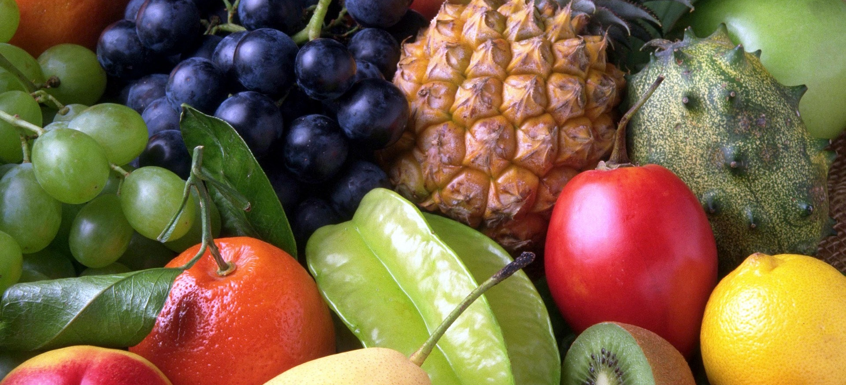
pratham
Fruit inventory management system
Notes:
© Copyright PresentationGo.com – The free PowerPoint template library

Slide 2
abstract
This project is aimed at developing an Fruit Inventory Management System (FIMS) for a fruit shop. This system can be used to store the details of the inventory, update the inventory based on the sale details and purchase details, produce receipts for sales and purchases, generate sales, purchase and inventory reports periodically etc.

Slide 3
Table of contents
Introduction
Product and stock
Purchase
Sales
Transactions
Conclusion

Slide 4
introduction
Basically a Inventory system is set of policies and controls that monitors levels of inventory and determines what levels should be maintained
“FRUIT INVENTORY MANAGEMENT SYSTEM” contains the details about Fruit Shop like, inventory, stock, selling, buying and billing of fruits and details about supplier, customer and their transactions.
Notes:
© Copyright PresentationGo.com – The free PowerPoint template library

Slide 5
introduction
This is one integrated system that contains both the user component (used by salespersons, sales managers, inventory managers etc).and the admin component (used by the administrators for performing admin level functions such as adding new items to the inventory, changing the price of an item etc).

Slide 6
Introduction
Fruit inventory management can be divided into 4 modules as follows:
Master
Purchase
Sales
Products and Stocks
Notes:
© Copyright PresentationGo.com – The free PowerPoint template library

Slide 7
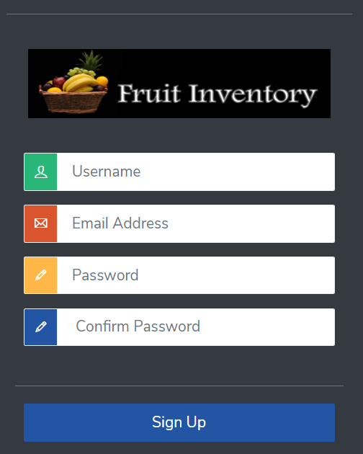
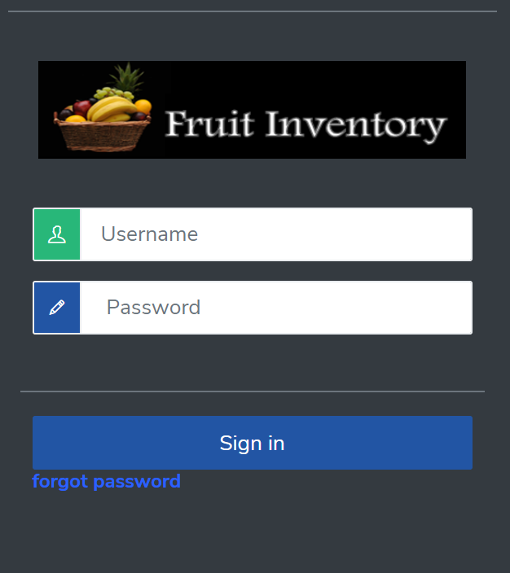
introduction

Slide 8
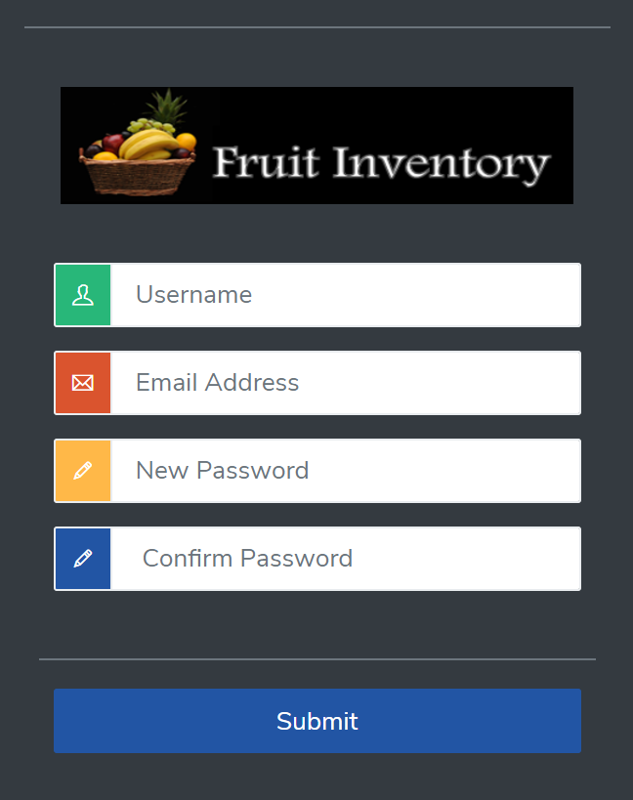
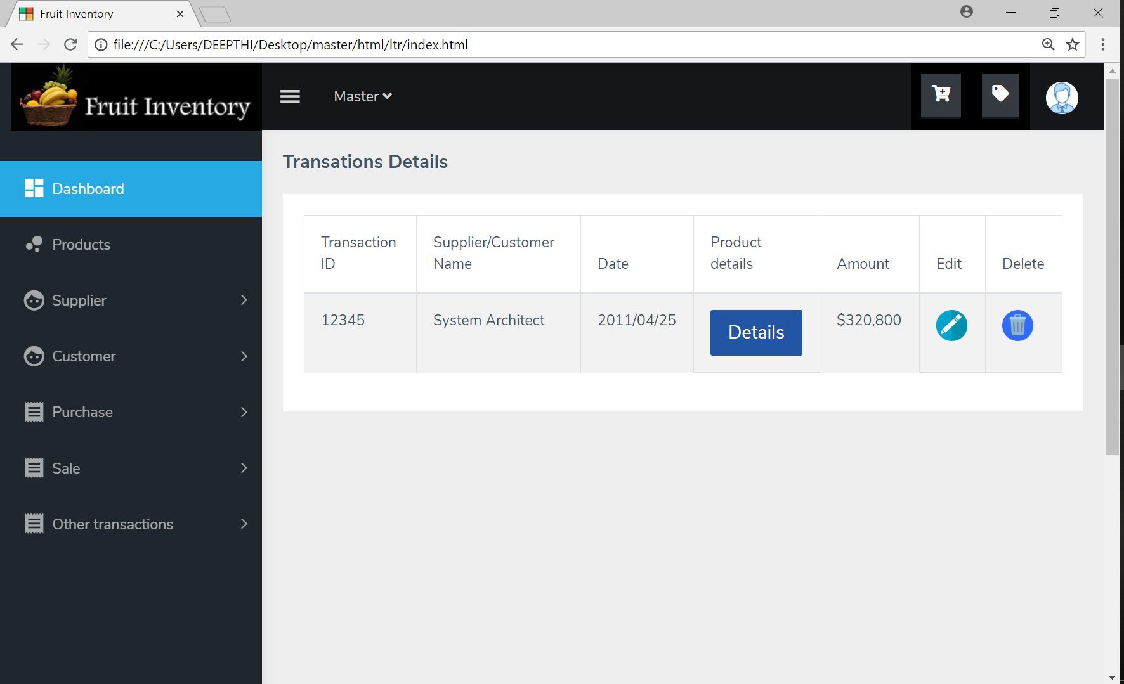
introduction

Slide 9
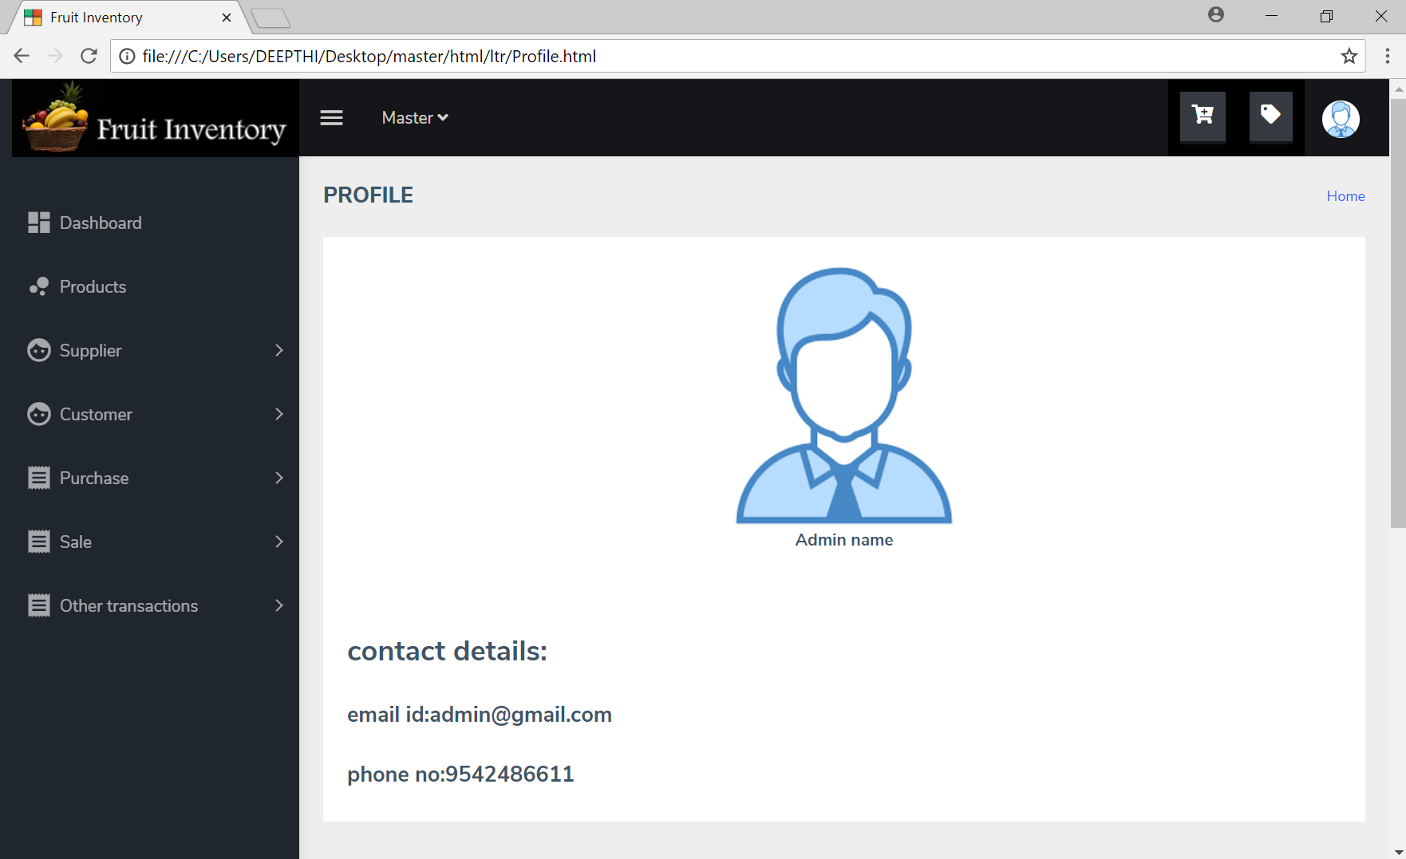
introduction

Slide 10
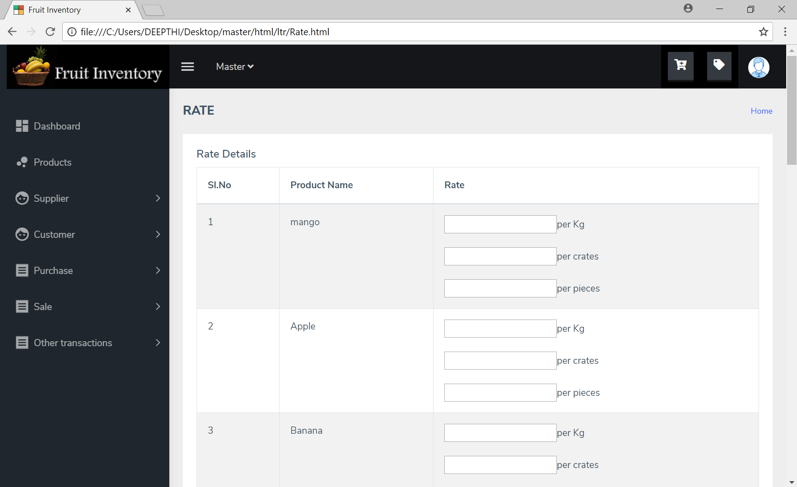
introduction

Slide 11
Product and stock
Fruit inventory management system
Notes:
© Copyright PresentationGo.com – The free PowerPoint template library

Slide 12
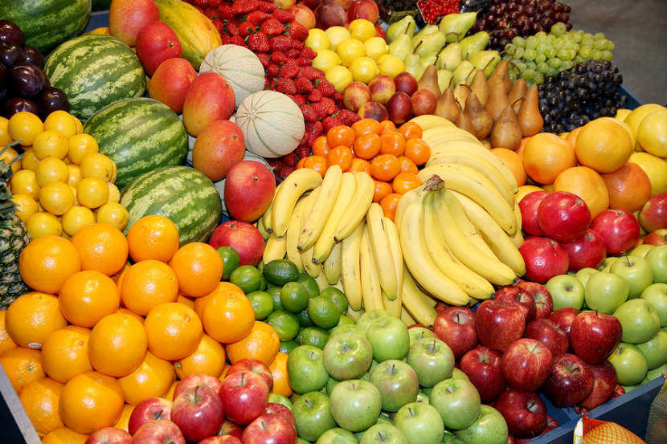
PRODUCT
PRODUCT-what is our product?
Fruits as product.
Adding new purchased products.
Available products and list.
The Product Section is where you define all of your products, saving time and consolidating information needed to provide outstanding list.
Notes:
© Copyright PresentationGo.com – The free PowerPoint template library

Slide 13
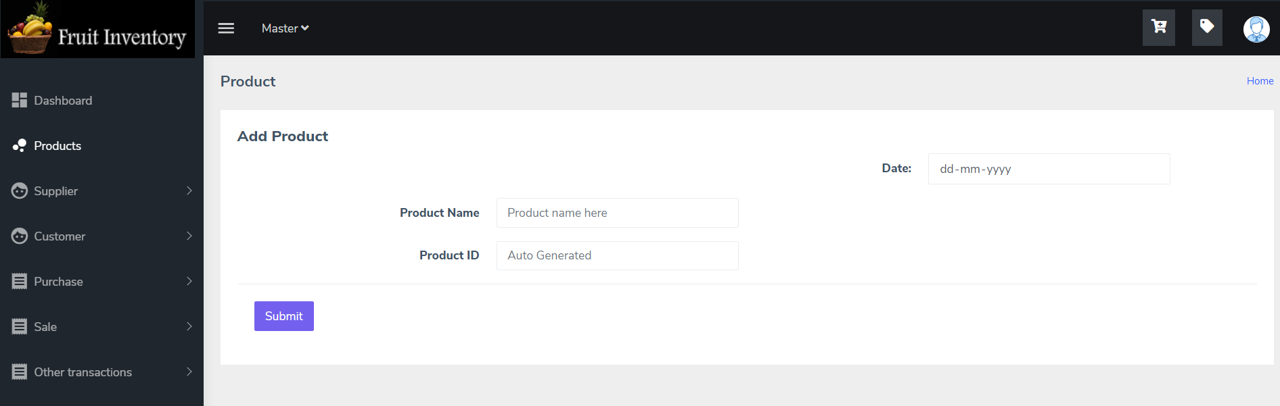
Product
ADDING new products using add product form and storing the products in the database.
Product name.
Auto generated Unique product Id.
Notes:
© Copyright PresentationGo.com – The free PowerPoint template library

Slide 14
Product
Process
Available Products
Stocks
Product list Table
Deleting and editing the products in the table
Maintaining the product list .
Purchase product
Store the stock
Sell product

Slide 15
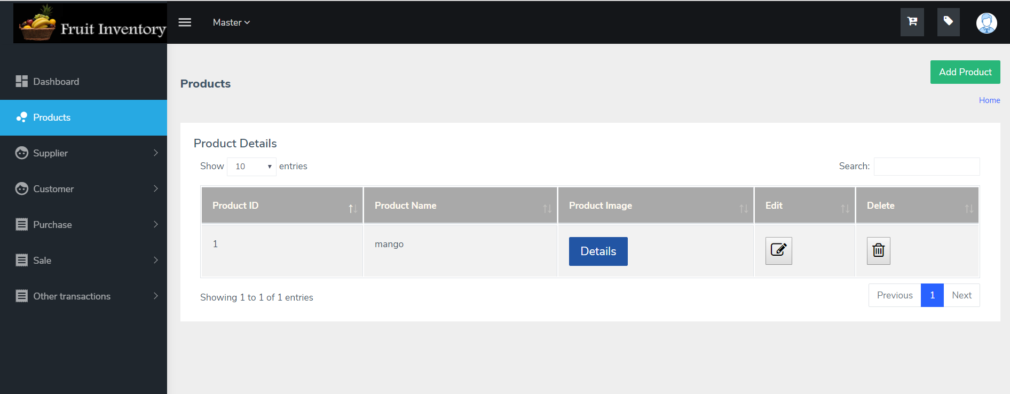
Product
Snapshot of Product details.

Slide 16
STOCK
A Stock is store or a supply of a goods .
Store-Goods that are ready for sale.
Supply-Goods that are ready to use.
Here we store Fruits as stock.
Stock
Stock Details.
Add Stock.
Notes:
© Copyright PresentationGo.com – The free PowerPoint template library

Slide 17

stock
Units used in “Fruit Inventory Management System” are Kg, Piece, Crate and Box.

Slide 18
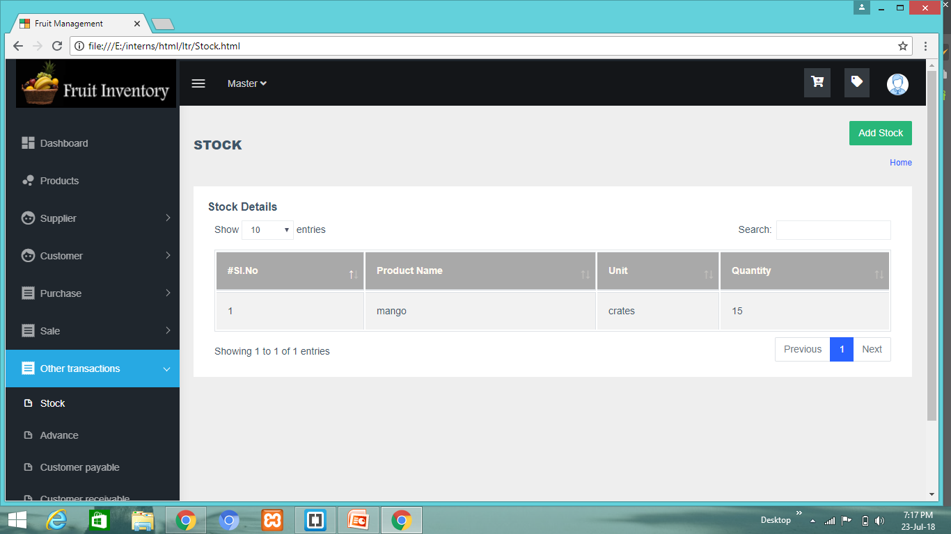
stock
Snapshot
Notes:
© Copyright PresentationGo.com – The free PowerPoint template library

Slide 19
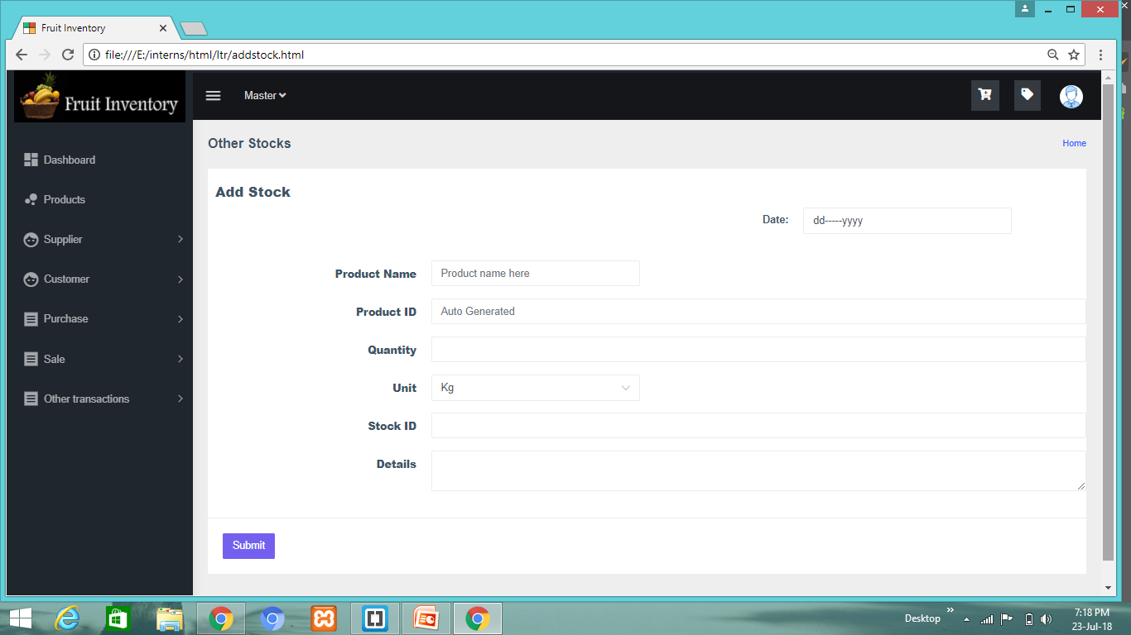
stock
snapshot

Slide 20
Purchase
A Fruit Inventory Management System
Notes:
© Copyright PresentationGo.com – The free PowerPoint template library

Slide 21


Purchase
Details
Purchasing of Products (in our case the fruits).
Goods are purchased from the supplier. He may be a farmer, or a other small vendors.
UI’s are created for maintaining the data of the suppliers, purchasing goods and keeping track of supplier payable and receivable.

Slide 22

Supplier
Supplier Registration and Details
Supplier- A person or organization that provides something needed such as a product or service.
Registration Form:
Supplier – ID.
Supplier Personal Information.
Address.
Bank Details.
Notes:
© Copyright PresentationGo.com – The free PowerPoint template library

Slide 23
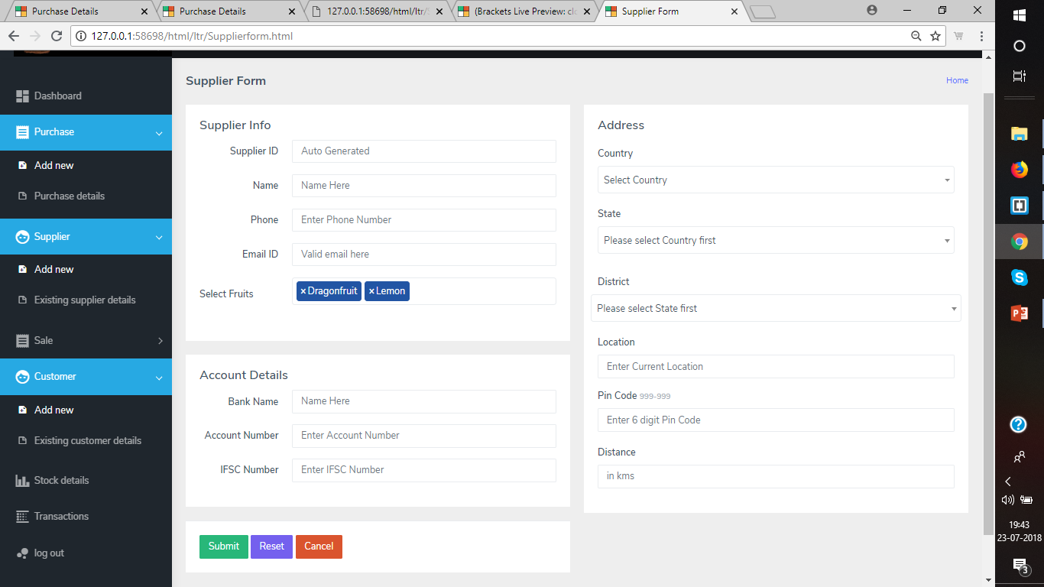
Supplier
Registration Form
Fig. Snapshot of Supplier Registration form

Slide 24
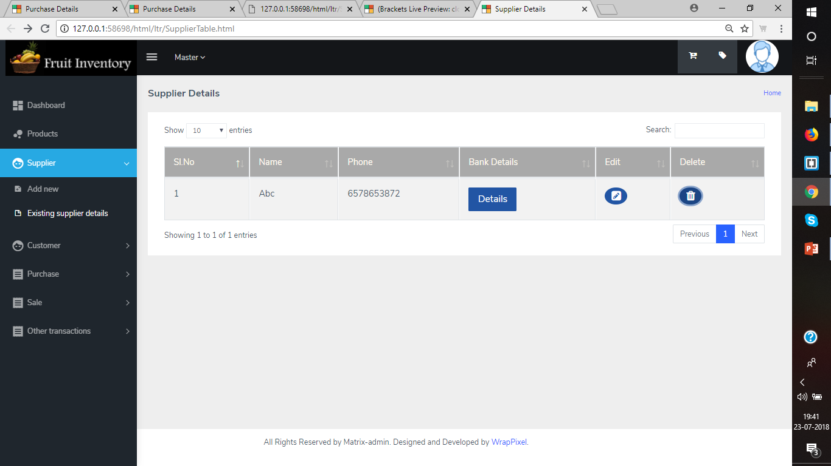
Supplier
details
Fig. Supplier Details
Notes:
© Copyright PresentationGo.com – The free PowerPoint template library

Slide 25


PURCHASE FORM
Supplier Details
Auto generating supplier details:
Personal Details
Address
Previous Transactions
Notes:
© Copyright PresentationGo.com – The free PowerPoint template library

Slide 26
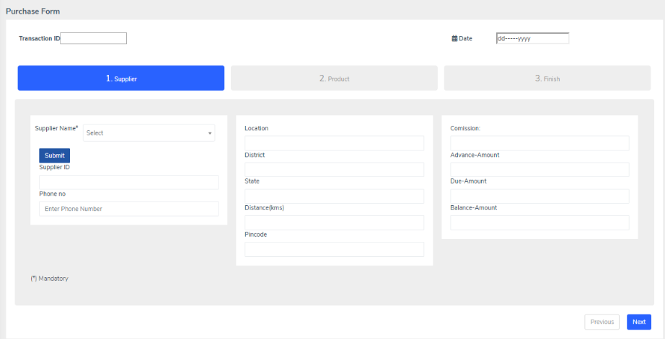
PURCHASE FORM
Supplier Details

Slide 27

PURCHASE FORM
Purchasing products
Enter Purchase details:
Product details
Expenses
Total Amount
Notes:
© Copyright PresentationGo.com – The free PowerPoint template library

Slide 28
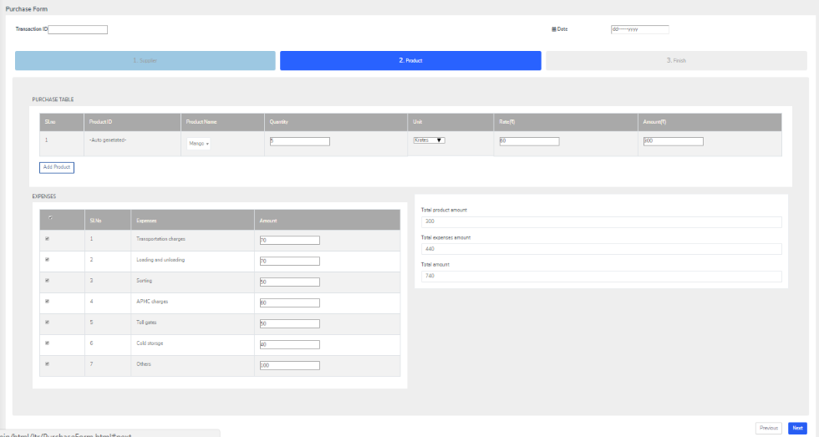
PURCHASE FORM
Purchasing products

Slide 29
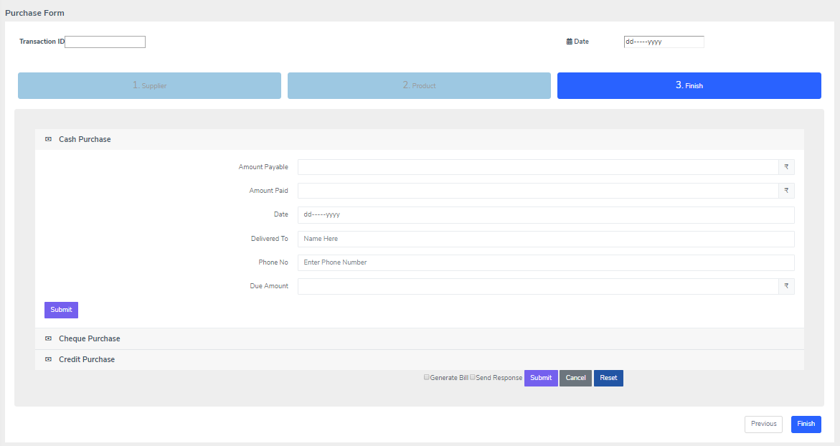
PURCHASE FORM
Purchasing products

Slide 30
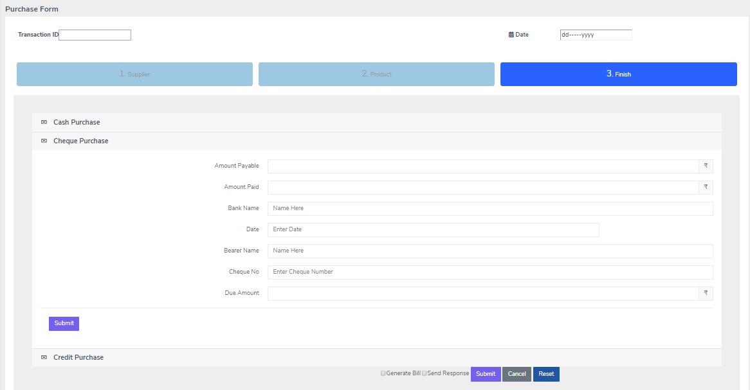
PURCHASE FORM
Purchasing products

Slide 31
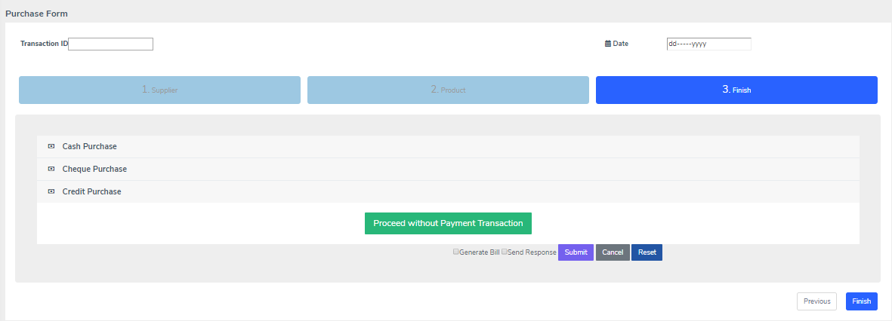
PURCHASE FORM
Purchasing products

Slide 32
PURCHASE TABLE
Complete purchase details
View Purchase Details:
Along with details of product purchased,
Edit and Delete option.

Slide 33
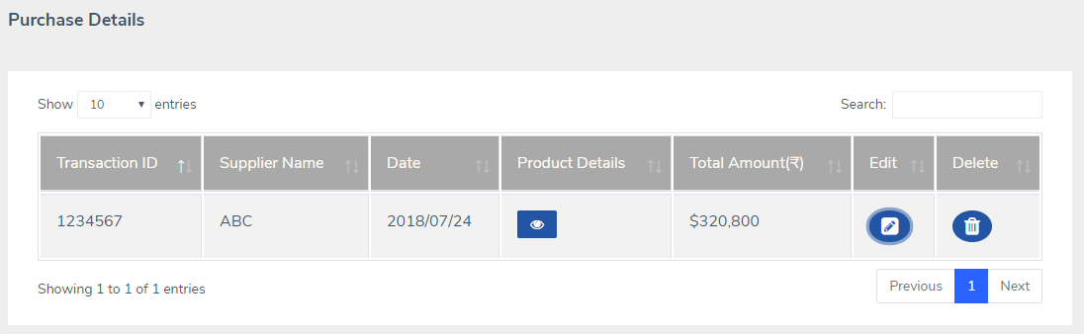
PURCHASE TABLE
Complete purchase details
Notes:
© Copyright PresentationGo.com – The free PowerPoint template library

Slide 34
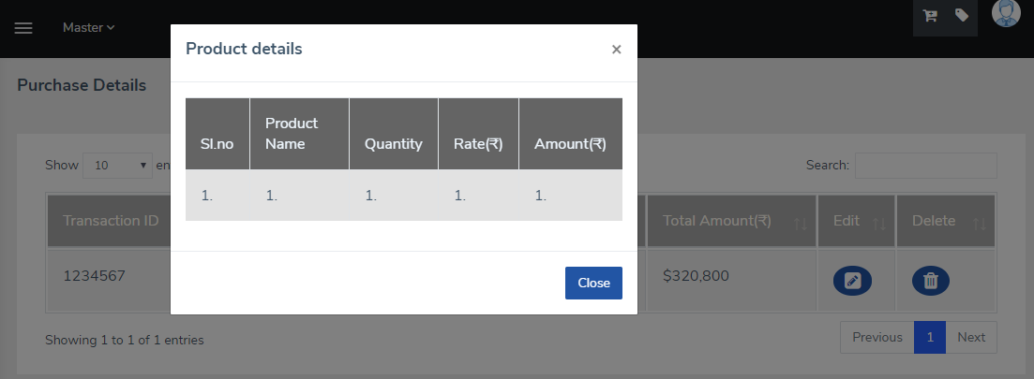
PURCHASE TABLE
Complete purchase details

Slide 35
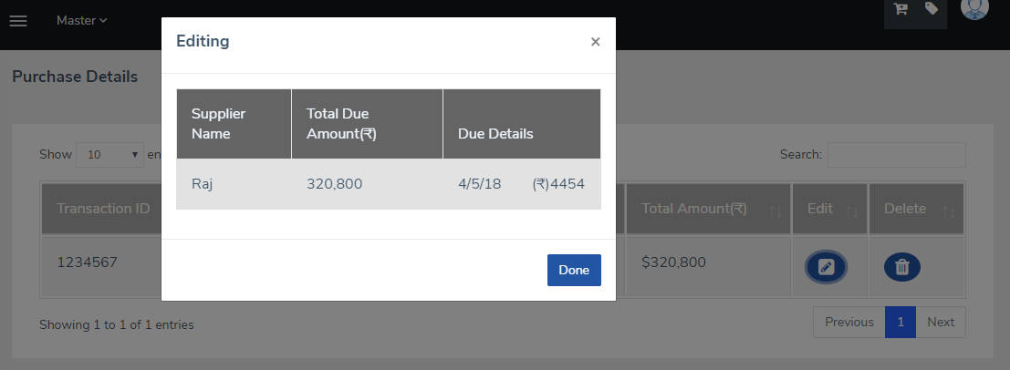
PURCHASE TABLE
Complete purchase details

Slide 36
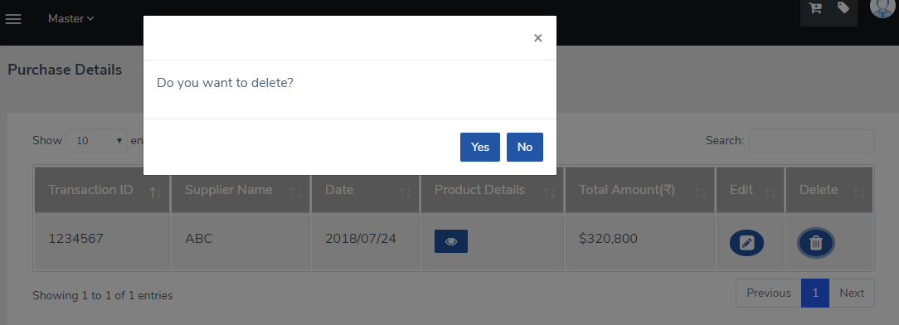
PURCHASE TABLE
Complete purchase details

Slide 37
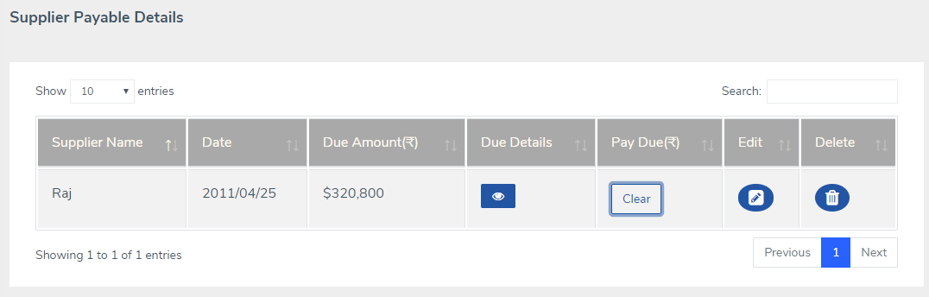
Supplier payable
Supplier payable is the money or a resource that a company shoud pay to a supplier for his goods or services

Slide 38
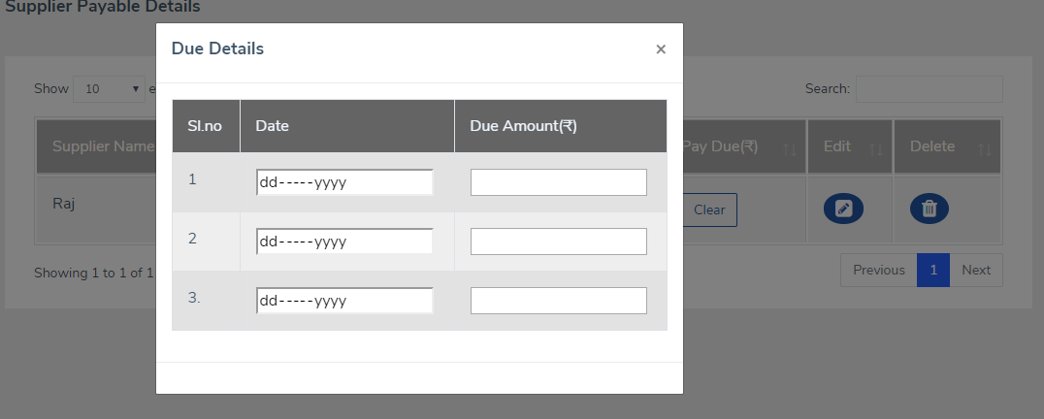
Supplier payable
Notes:
© Copyright PresentationGo.com – The free PowerPoint template library

Slide 39
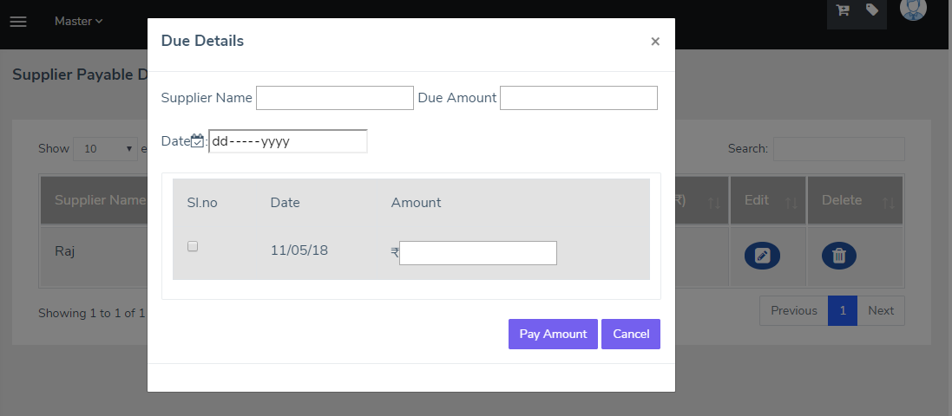
Supplier payable
Notes:
© Copyright PresentationGo.com – The free PowerPoint template library

Slide 40
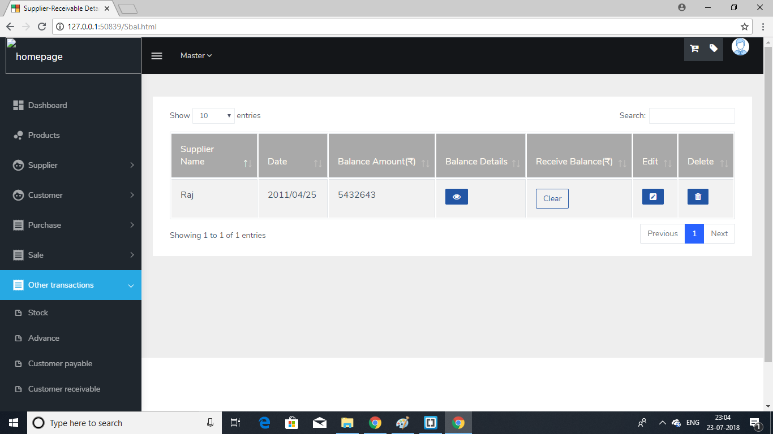
Supplier receivable
Supplier receivable is the money or resource that a company should get from a supplier .

Slide 41
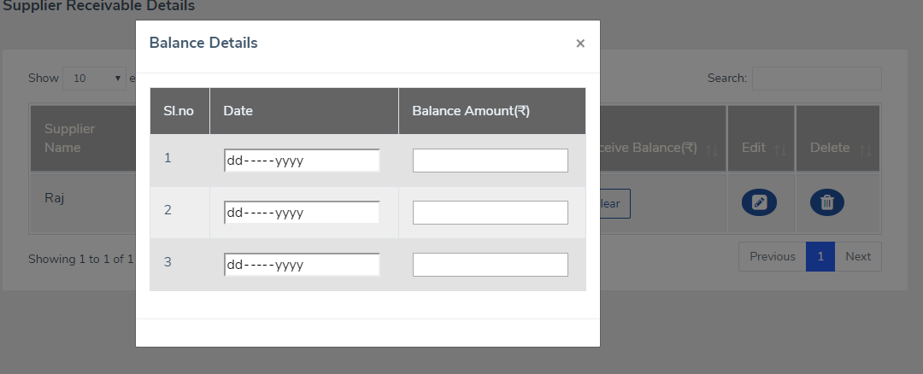
Supplier receivable

Slide 42
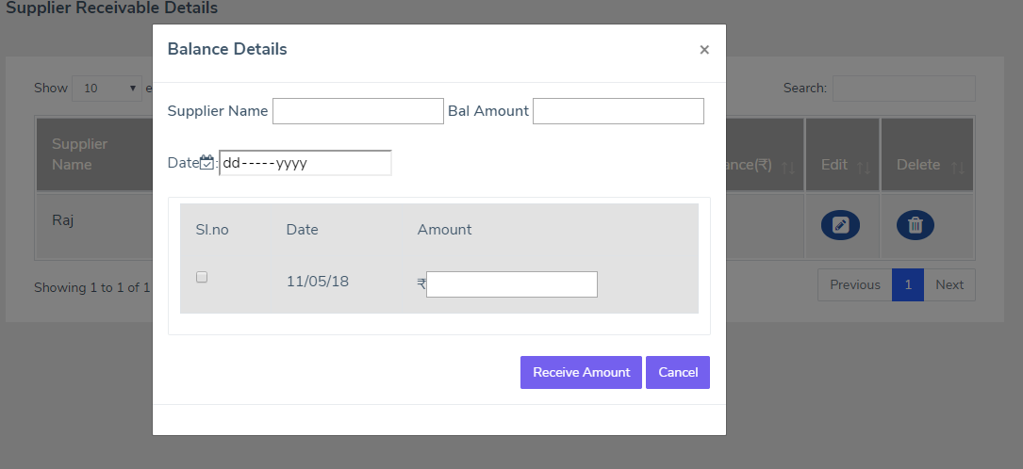
Supplier receivable

Slide 43
sale
Fruit inventory management system
Notes:
© Copyright PresentationGo.com – The free PowerPoint template library

Slide 44

Customer
A person who buys fruits and services from a shop or with whom has to deal.
To add a new customer we are using customer form.
To list the details about that customer we are using customer details table.
Notes:
© Copyright PresentationGo.com – The free PowerPoint template library

Slide 45
customer
Customer form:
Customer name
Customer Id
Address
Phone no
Notes:
© Copyright PresentationGo.com – The free PowerPoint template library

Slide 46
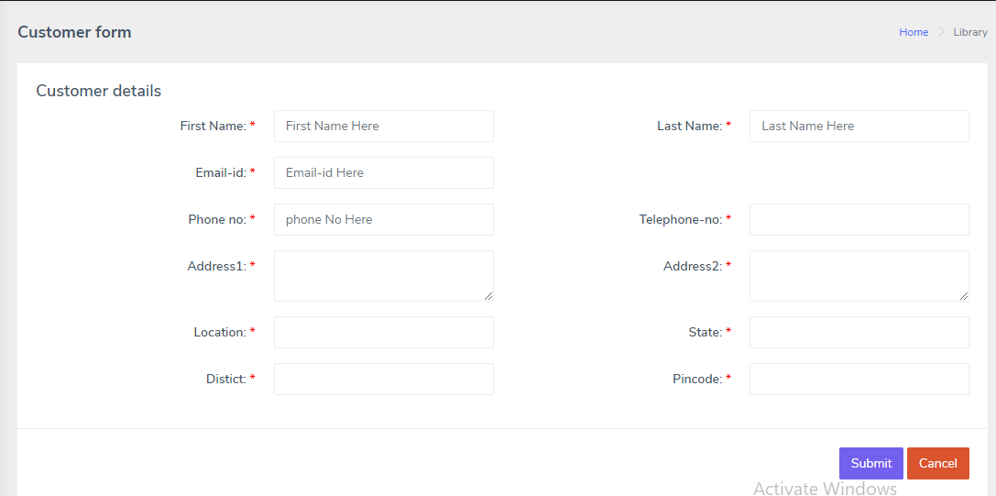
customer
Notes:
© Copyright PresentationGo.com – The free PowerPoint template library

Slide 47
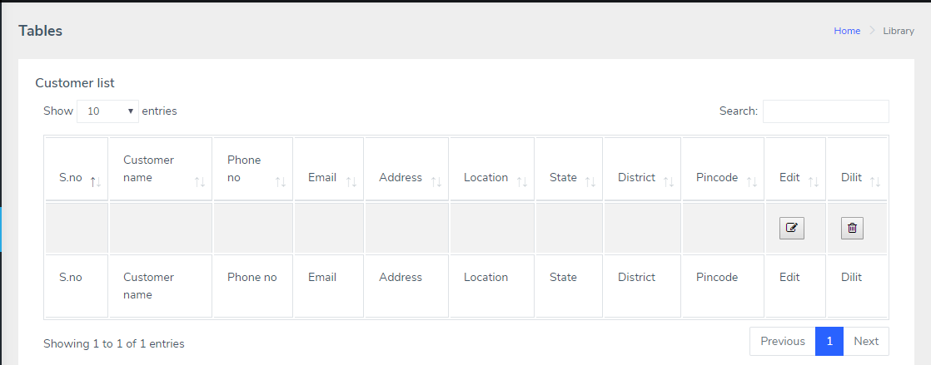
Customer
Fig : Represent the of details of customer in the form of tables
Pratham - Fruit inventory system

Slide 48
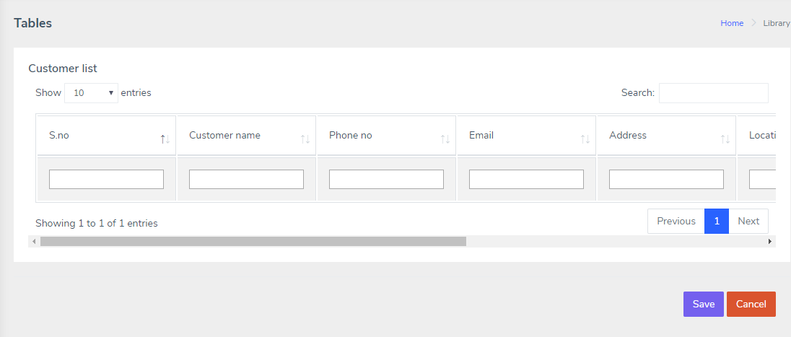
customer
Fig : customerEdit form
Pratham - Fruit inventory system

Slide 49
Sales
Product SALE AND SALES DETAIL
Product Sale:
Customer will Purchase some Products.
Entering Product Details to Sales form.
The form which will takes input like Bill no,Date,Customer Name,Ph.no,Quantity,Price etc…
Submitting inputs.
Mode of Payment:
Cash Mode:Cash,Cheque,Other modes
Credit:Balance.

Slide 50
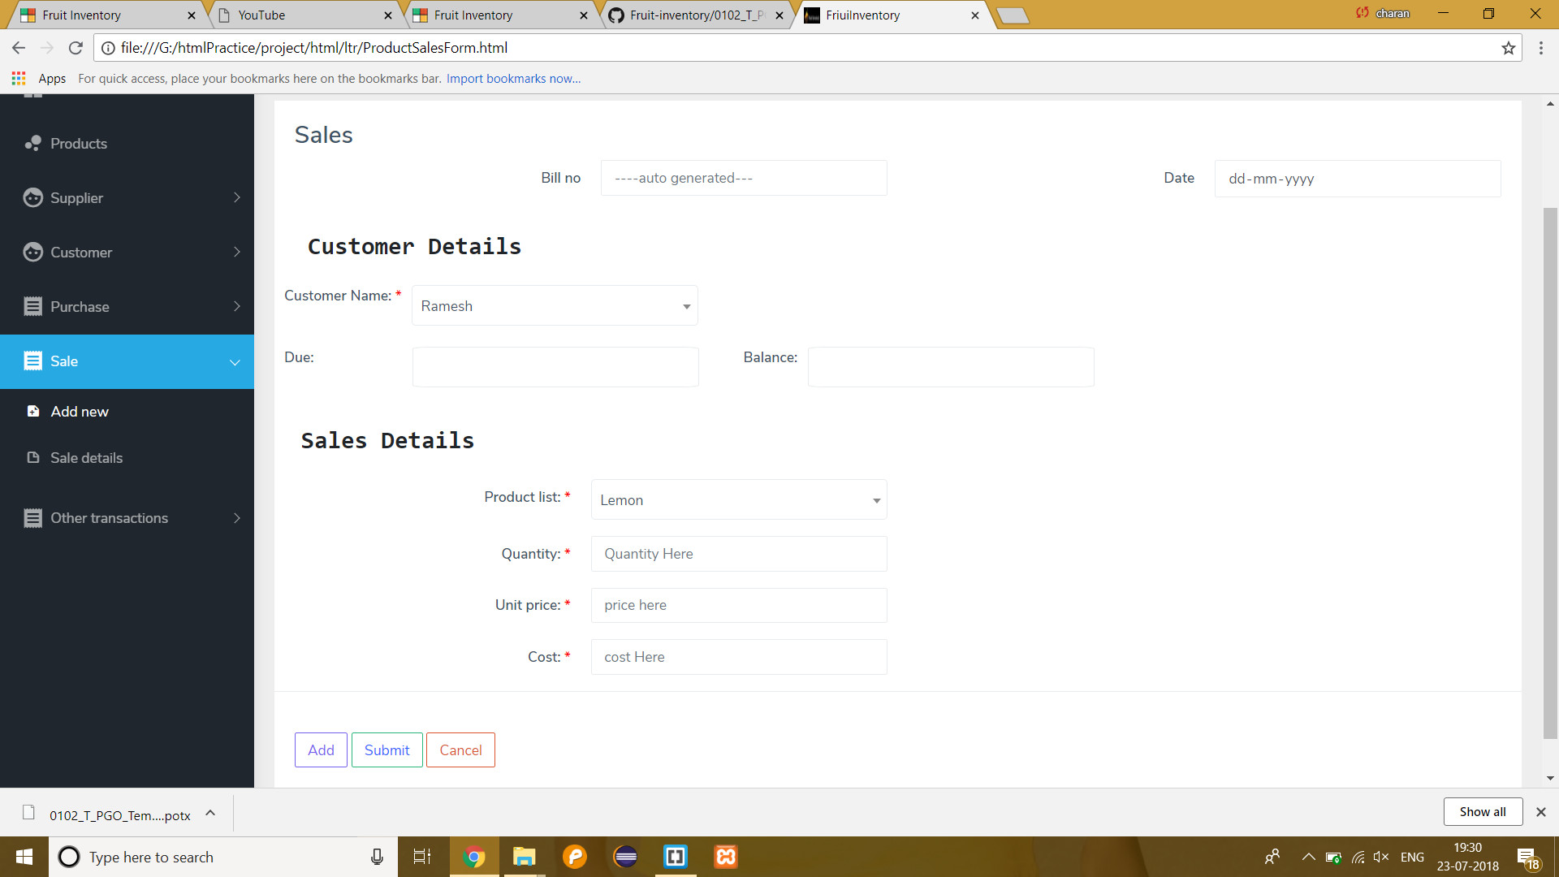
Sales
Product SALE AND SALES DETAIL
Sales Form

Slide 51
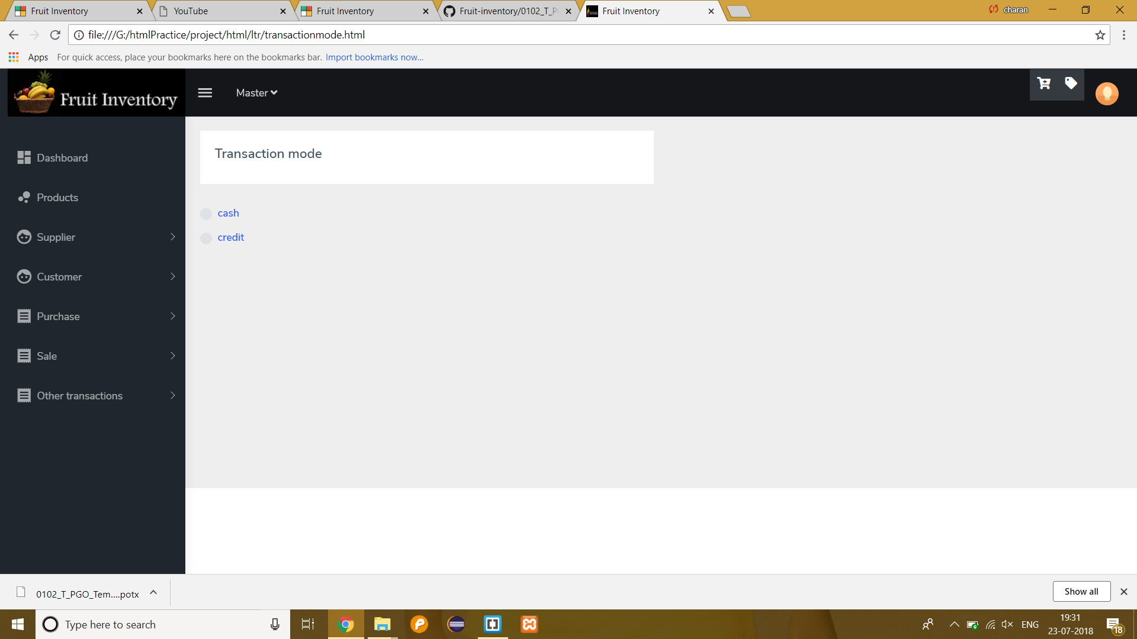
Sales
Product SALE AND SALES DETAIL
Transaction Mode

Slide 52
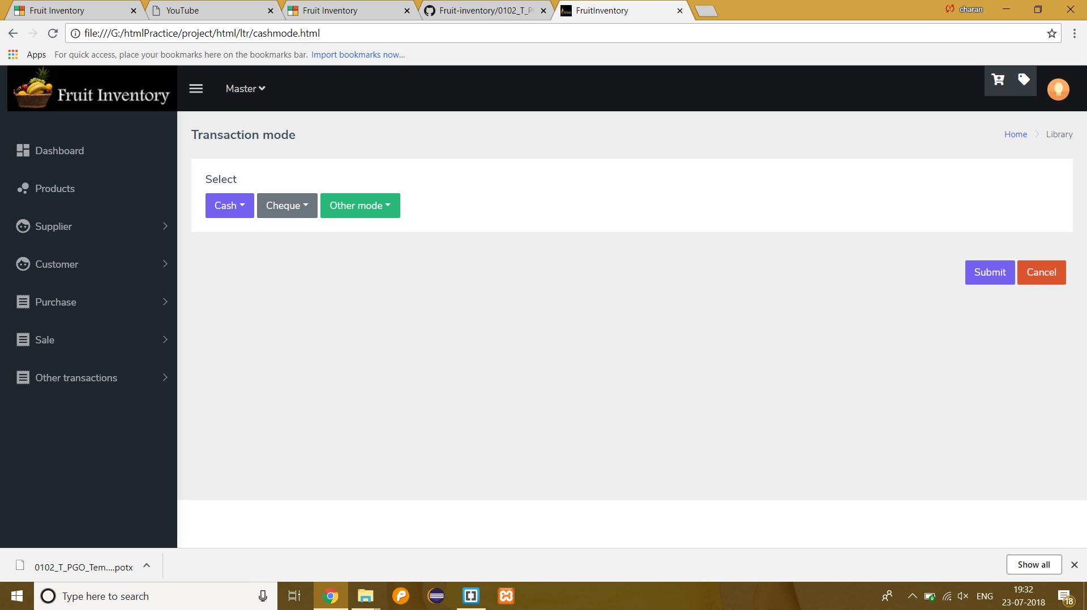
Sales
Product SALE AND SALES DETAIL
Cash Mode

Slide 53
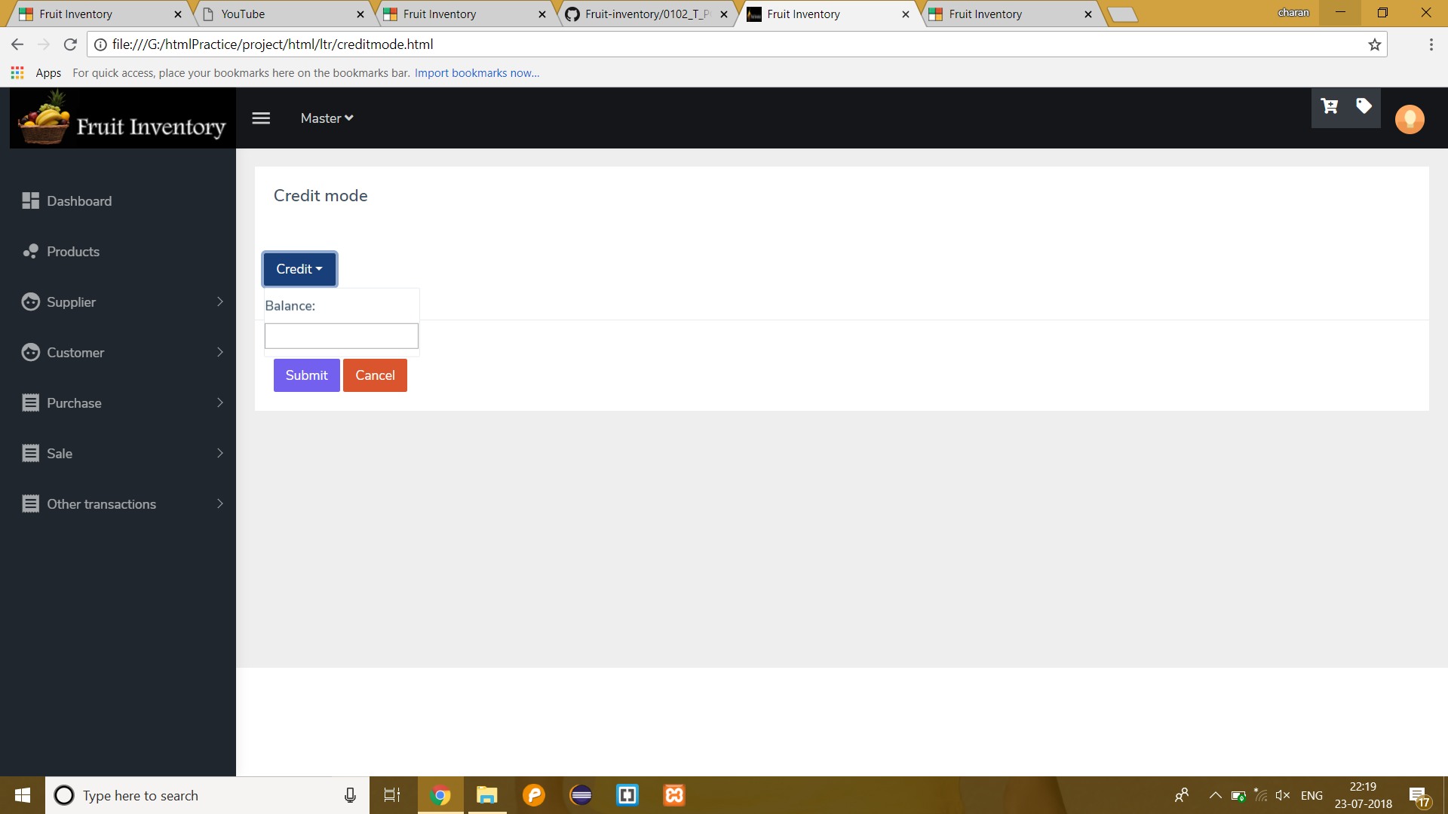
Sales
Product SALE AND SALES DETAIL
Credit Mode

Slide 54
Sales
Product SALE AND SALES DETAIL
Sales Details:
Its like a Table.
Whole details of the products which are Purchased by the Customer.
Details in the sense Products Name,Cost,etc…
Searching,Editing and Deleting Options.
Modals for Product Details and Amount Details.

Slide 55
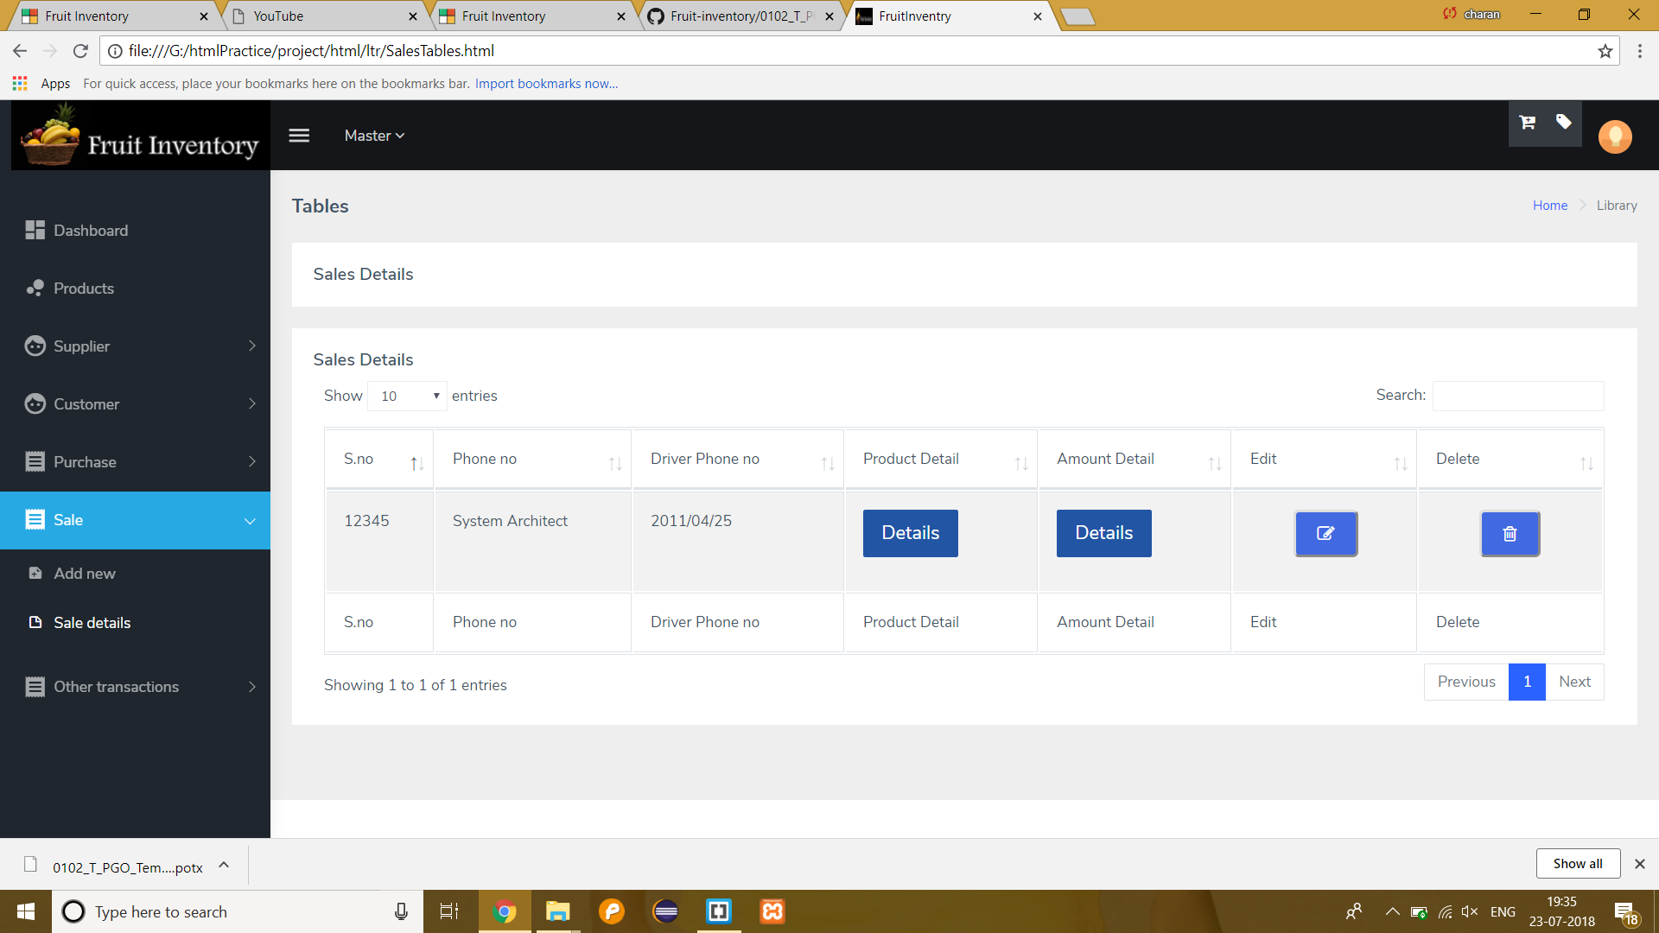
Sales
Product SALE AND SALES DETAIL
Sales Details

Slide 56
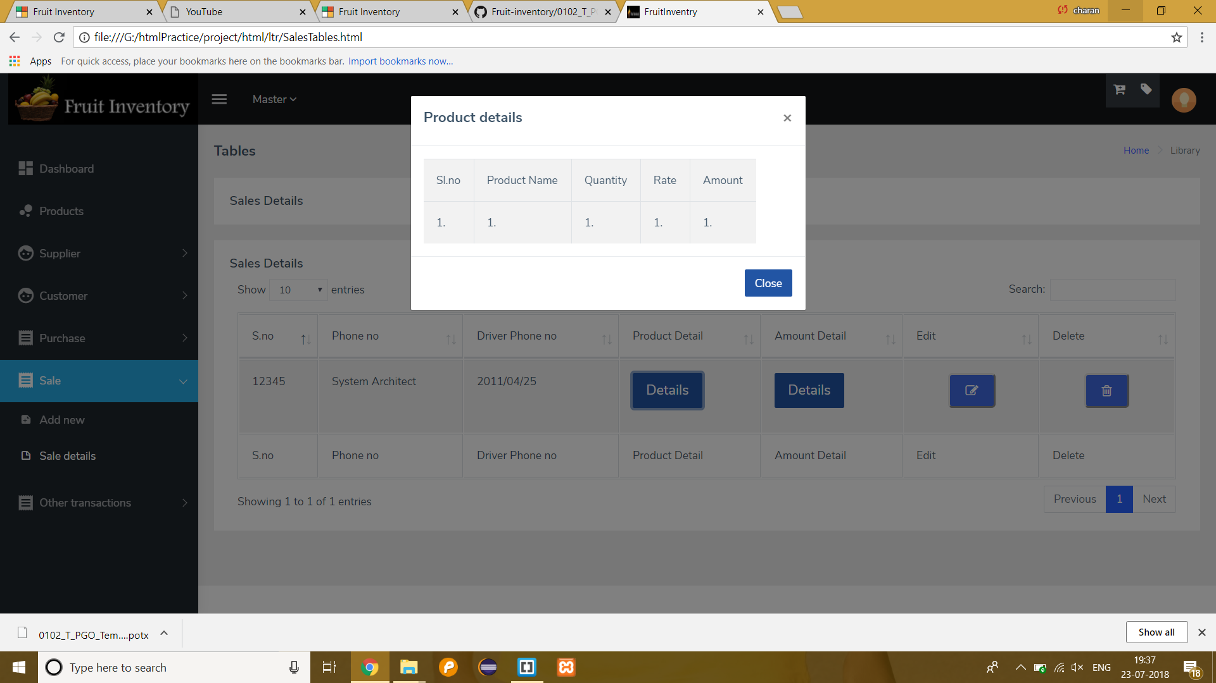
Sales
Product SALE AND SALES DETAIL
Product Details

Slide 57

Sales
Product SALE AND SALES DETAIL
Amount Details

Slide 58
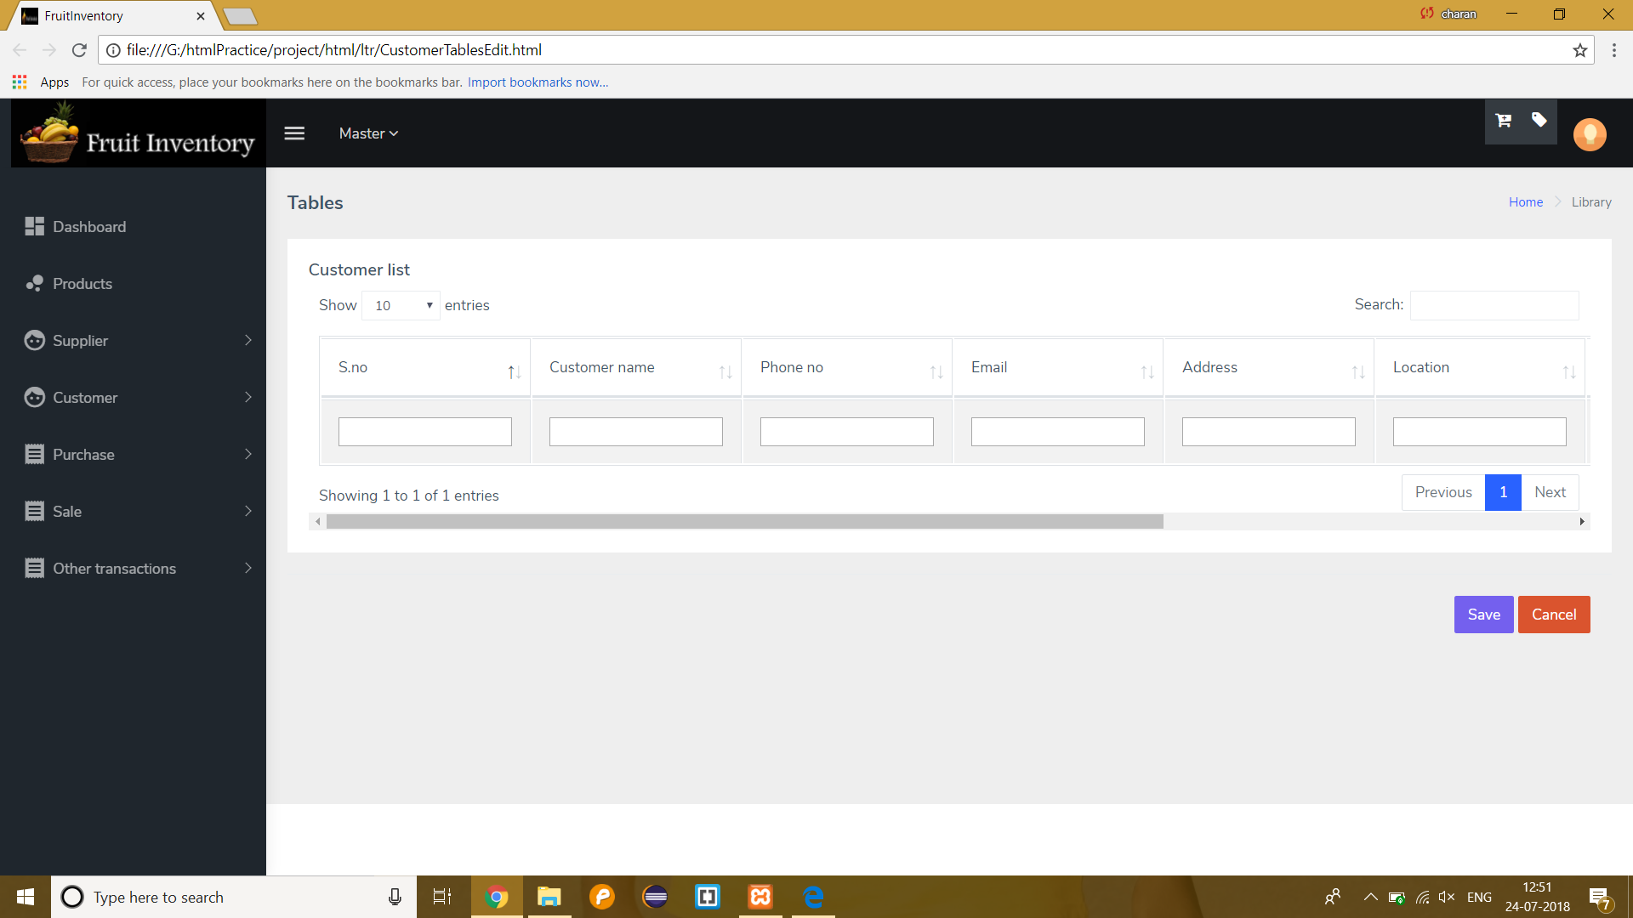
Sales
Product SALE AND SALES DETAIL
Table Editing

Slide 59
Customer payable and receivable
Customer payable
The amount the customer should pay is the amount payable
Customer payable table contains Customer name, Date and Due.
Due column contains ‘clear’ Button.
By clicking on clear button it goes to Next page, that contains Customer name, amount Payable and paid, due and particulars.
Notes:
© Copyright PresentationGo.com – The free PowerPoint template library

Slide 60
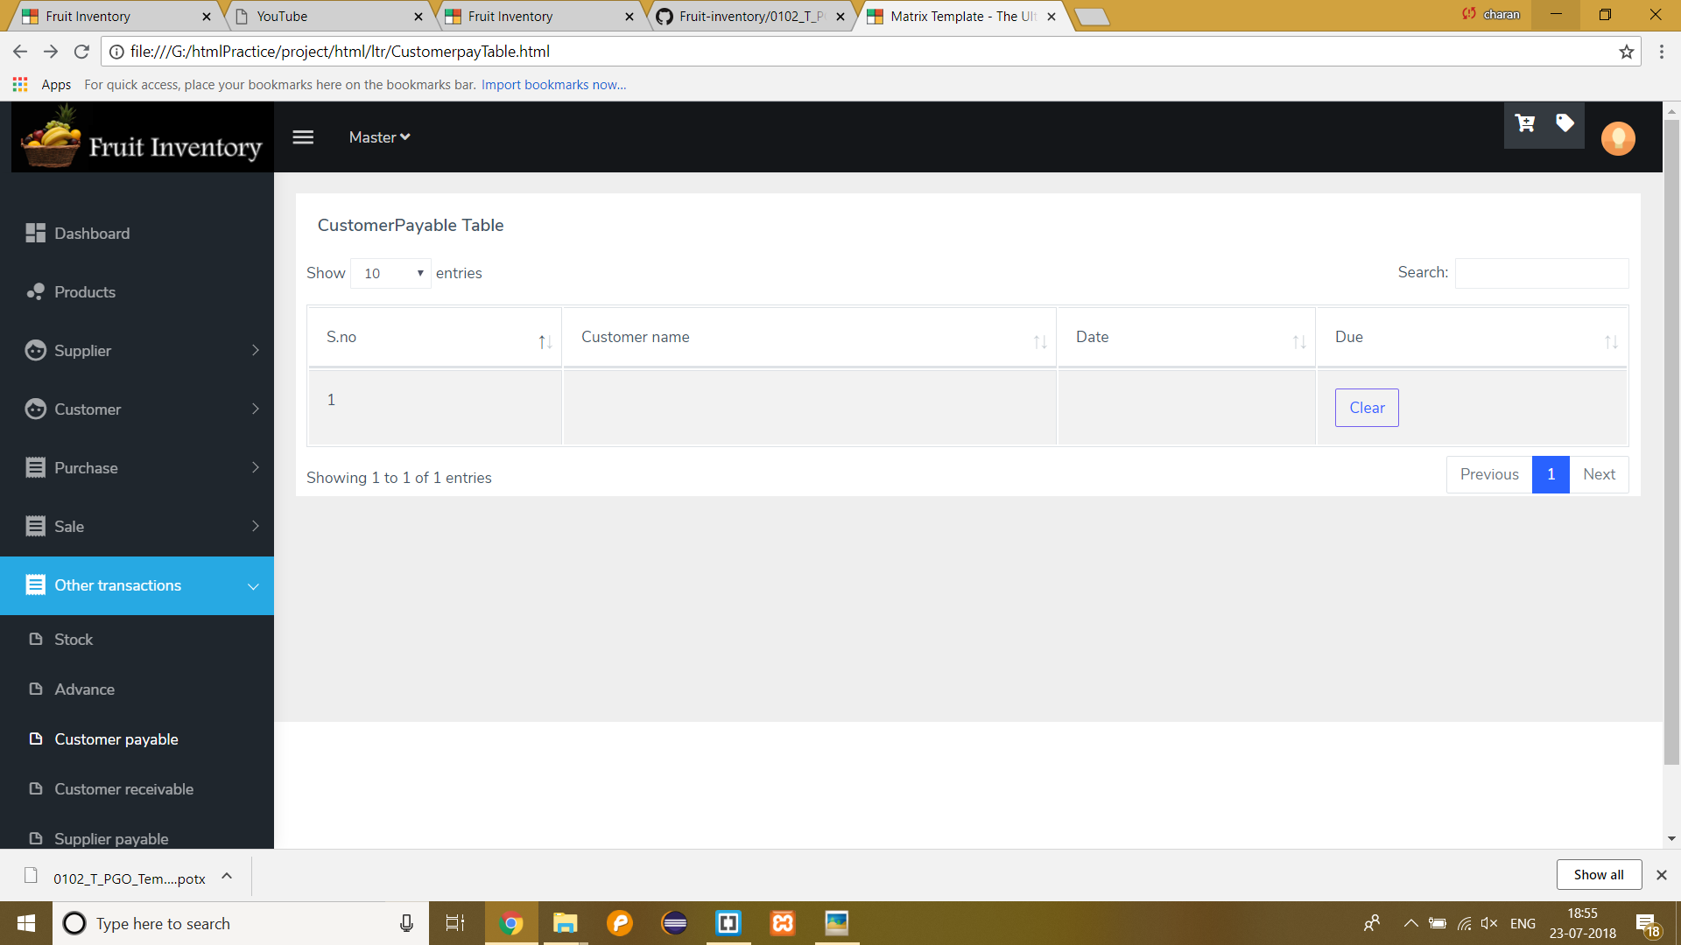
Customer payable and receivable
Customer payable
Customer payable table:
Notes:
© Copyright PresentationGo.com – The free PowerPoint template library

Slide 61
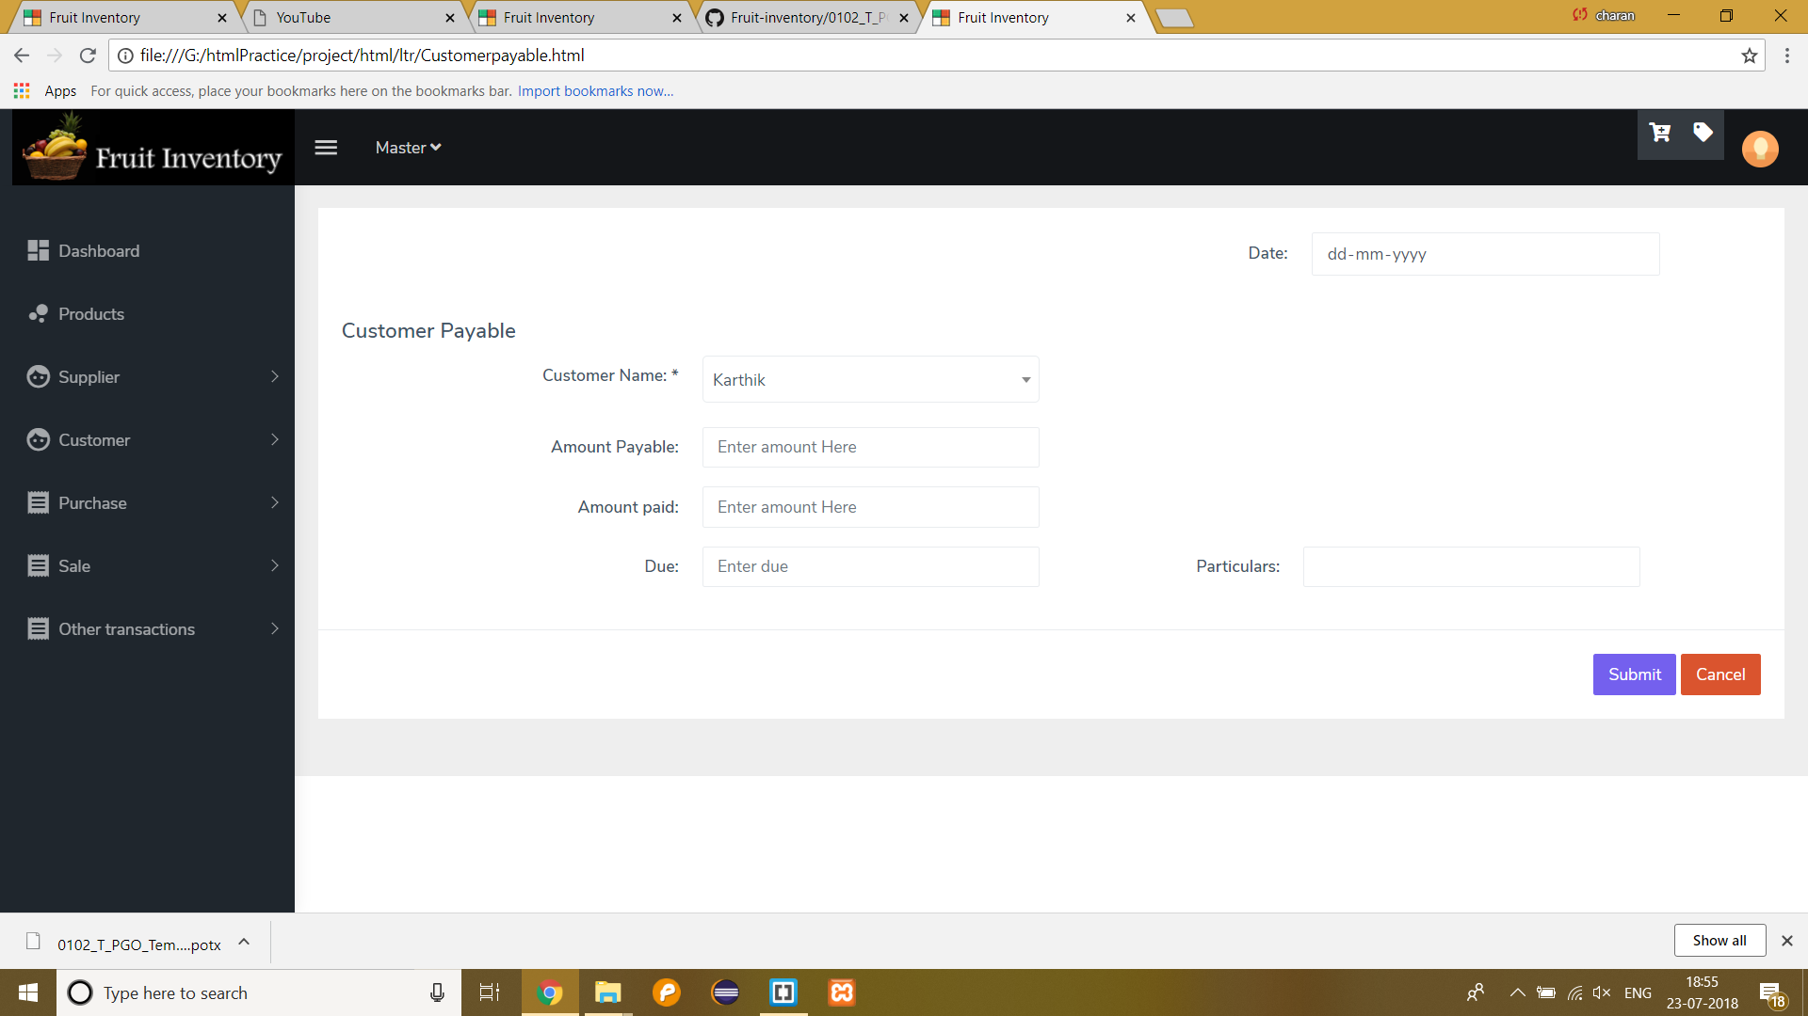
Customer payable and receivable
Customer payable
Customer payable page:
Notes:
© Copyright PresentationGo.com – The free PowerPoint template library

Slide 62
Customer payable and receivable
Customer receivable
Accounts receivable are amounts a company has a right to collect because it sold goods or services on credit to a customer
Customer receivable table contains Customer name, Date and Balance
By clicking on “Clear” button next page will be opened which contains amount receivable and amount received ,particulars and balance.

Slide 63

Customer payable and receivable
Customer receivable
Customer receivable table:

Slide 64
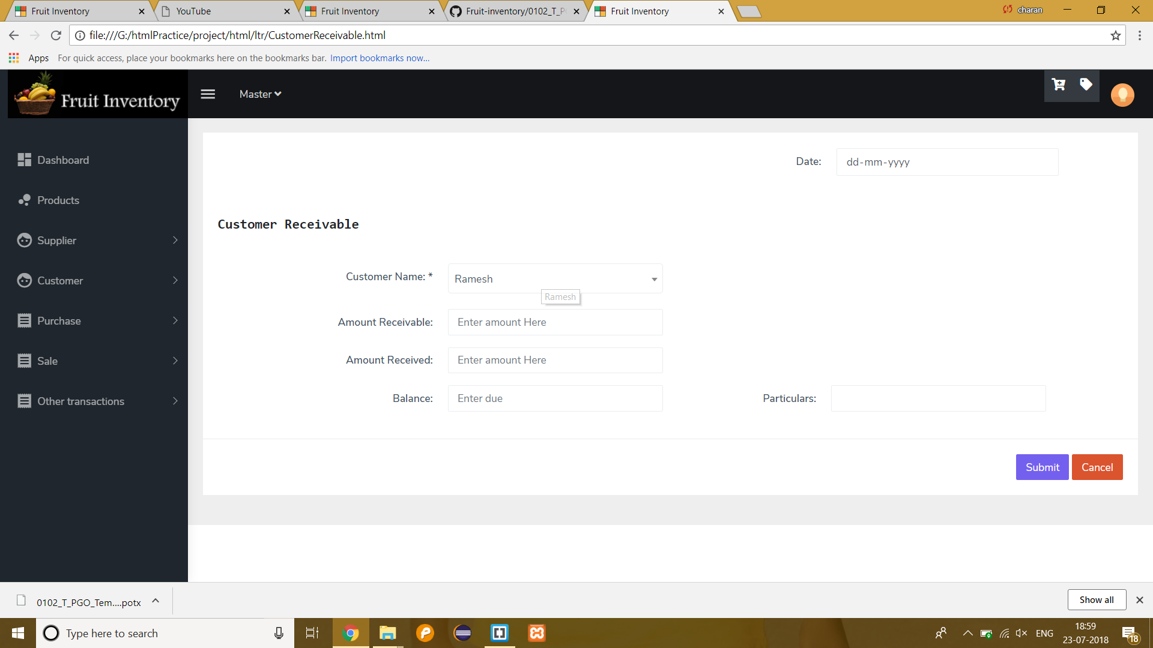
Customer payable and receivable
Customer receivable
Customer receivable page:

Slide 65
transaction
Fruit inventory management system
Notes:
© Copyright PresentationGo.com – The free PowerPoint template library

Slide 66
TRansactions
Cashbook
A cash book is of primary entry. All transactions are recorded in the cash book.
It keep record of only cash transactions.
All receipts are recorded in debit side.
All payments are recorded in credit side.
Notes:
© Copyright PresentationGo.com – The free PowerPoint template library

Slide 67
transactions
Cash book
It also contains Debit Credit and Balance.
It also contains “Add cash” button. By clicking on it the next page will be opened which contains Date, Particulars and amount.
The cash book contains particulars which describes the transactions that is carried out in that particular day.

Slide 68
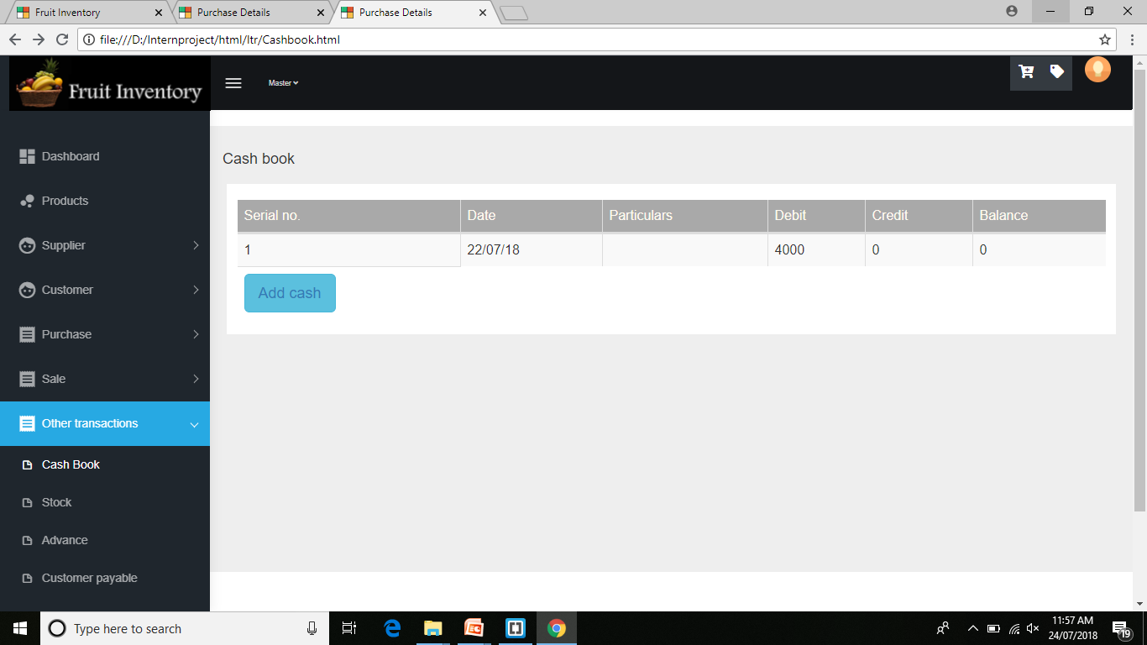
Transactions
Cash book

Slide 69
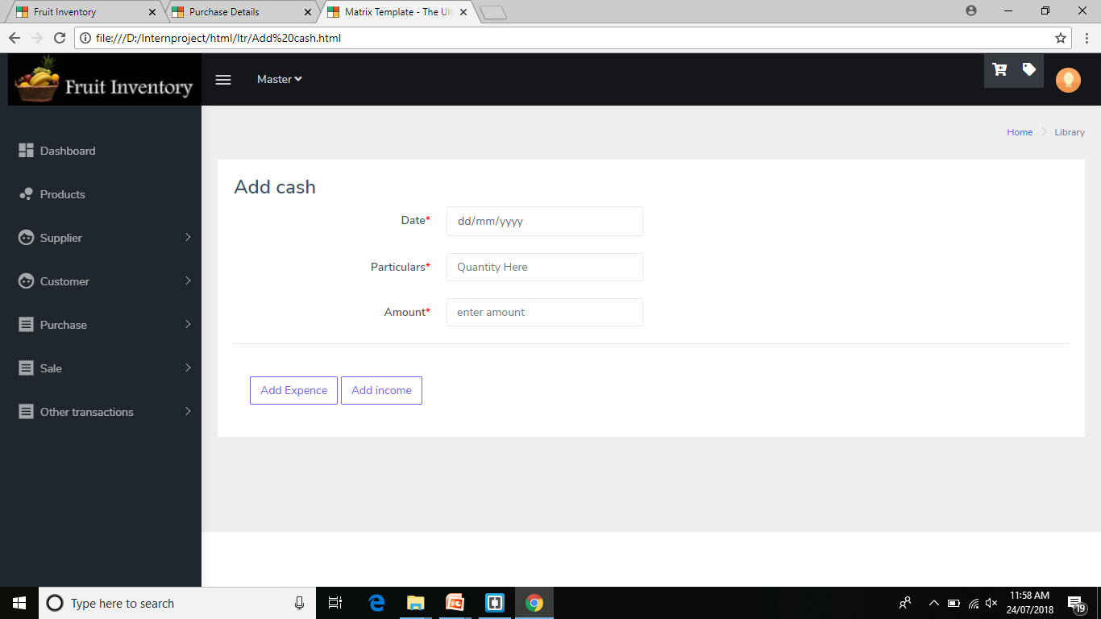
transactions
Add cash

Slide 70
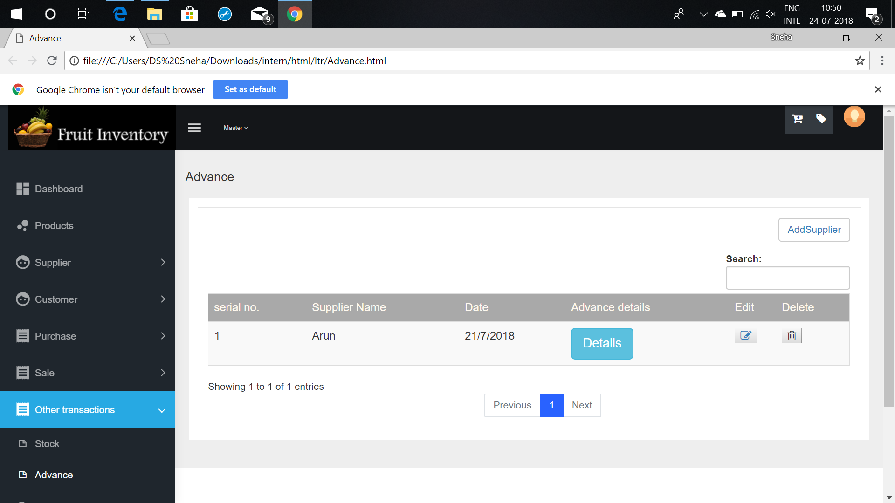
TRANSACTIONS
ADVANCE

Slide 71
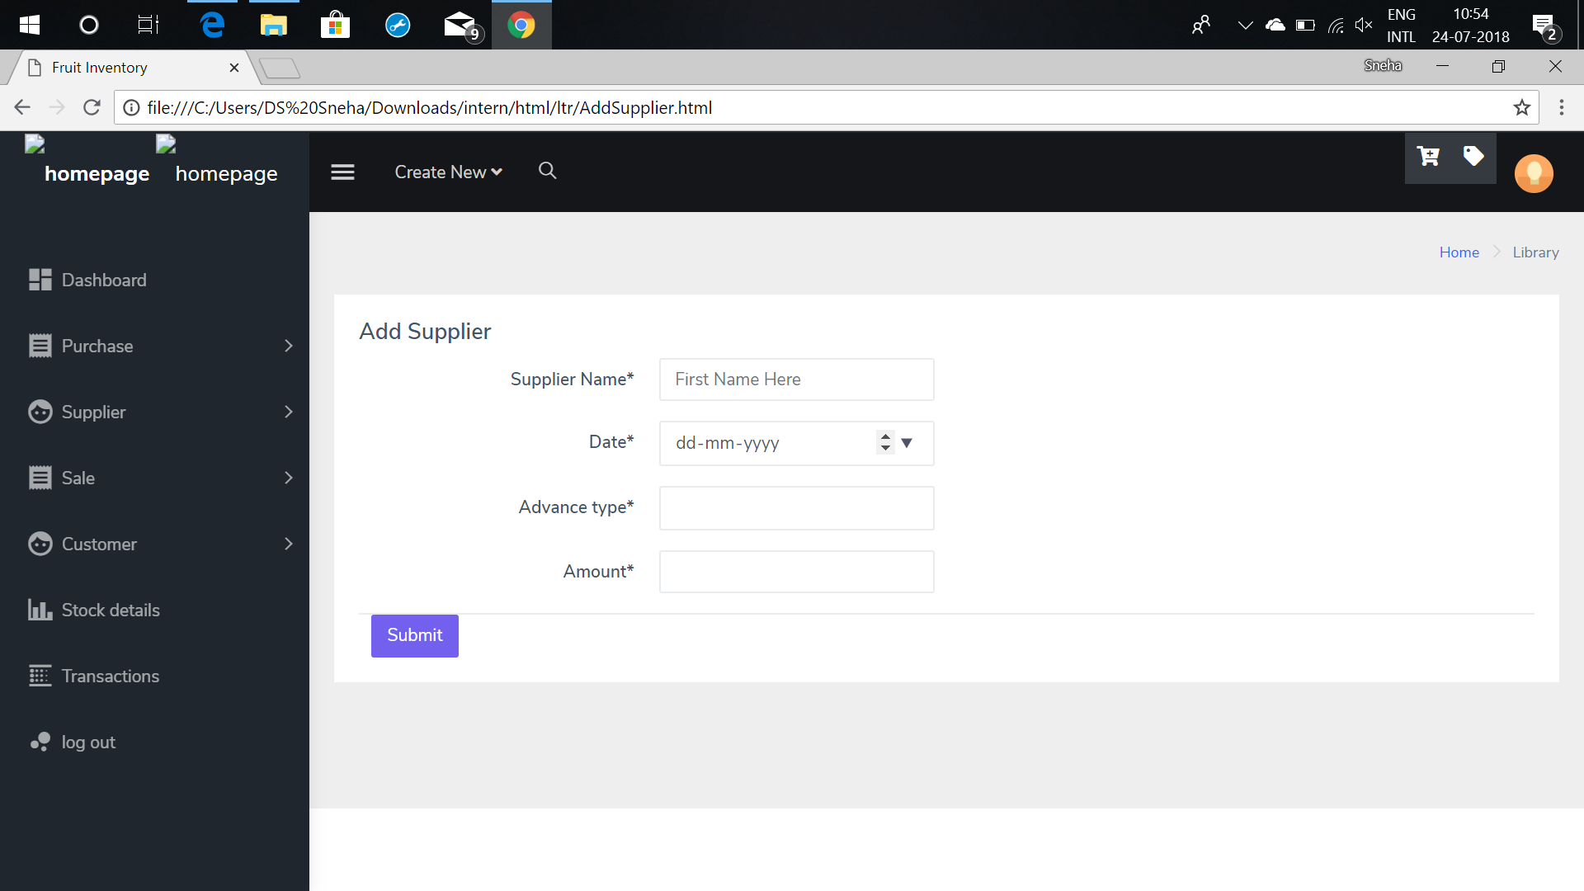
Transactions
Add supplier

Slide 72
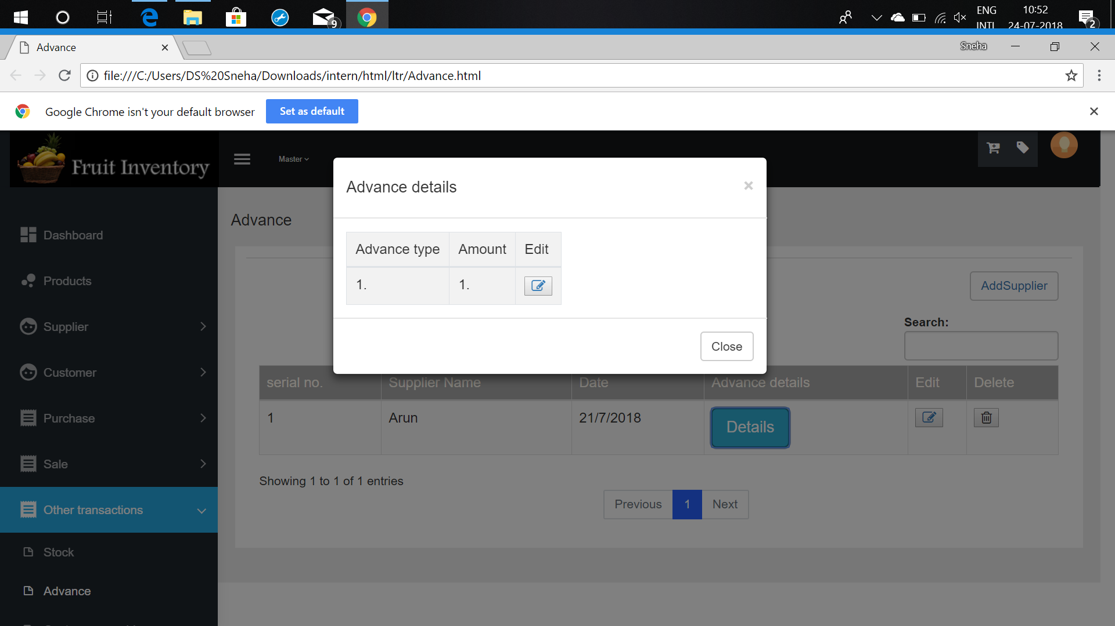
transactions
Advance details

Slide 73
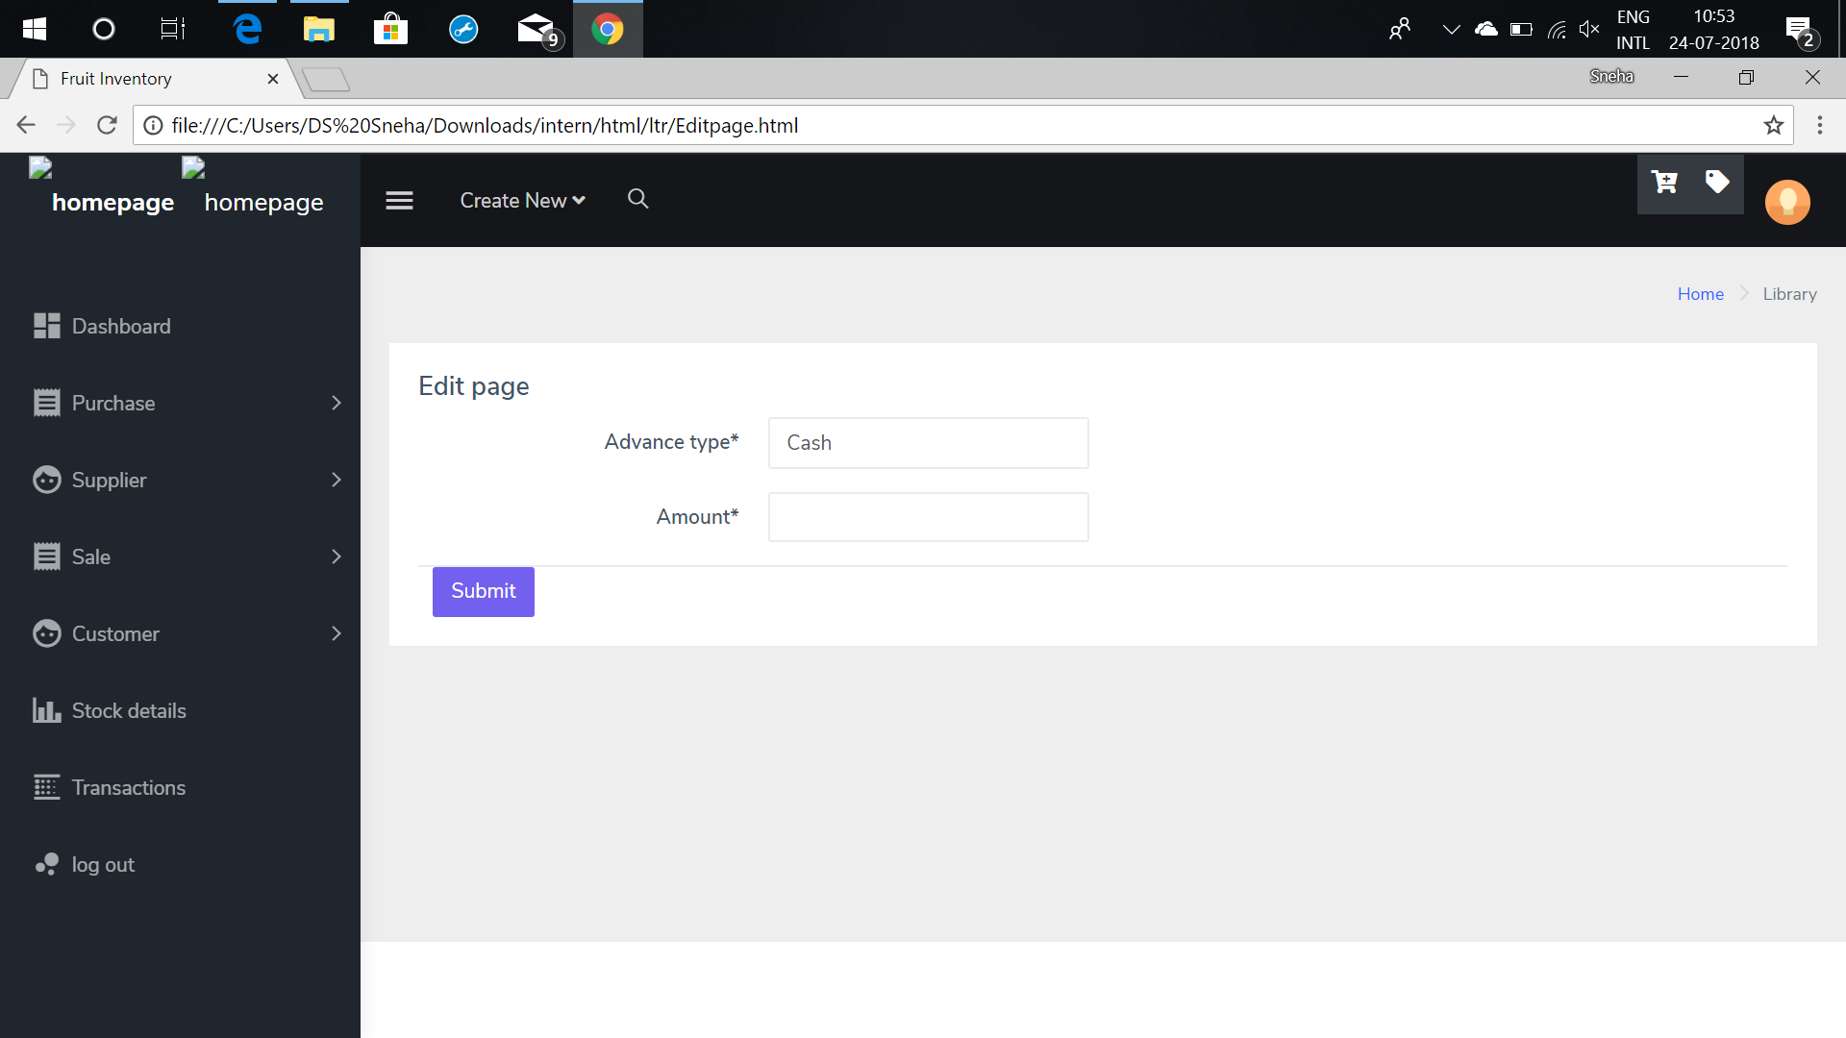
transactions
Edit advance details

Slide 74
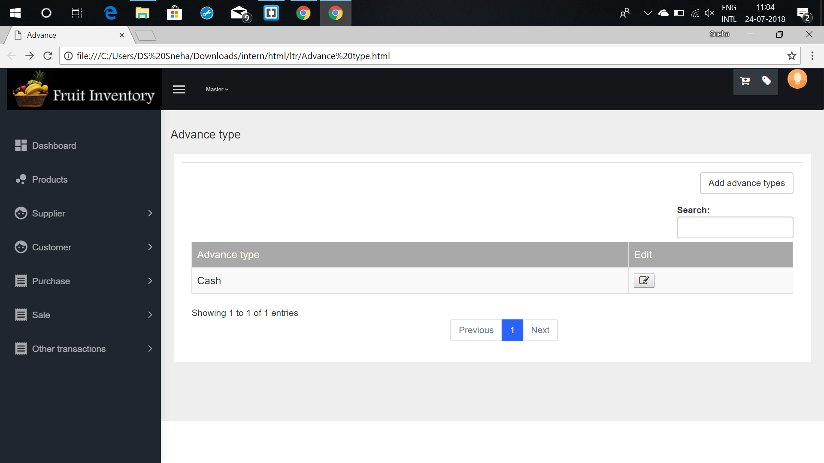
transactions
Advance type

Slide 75
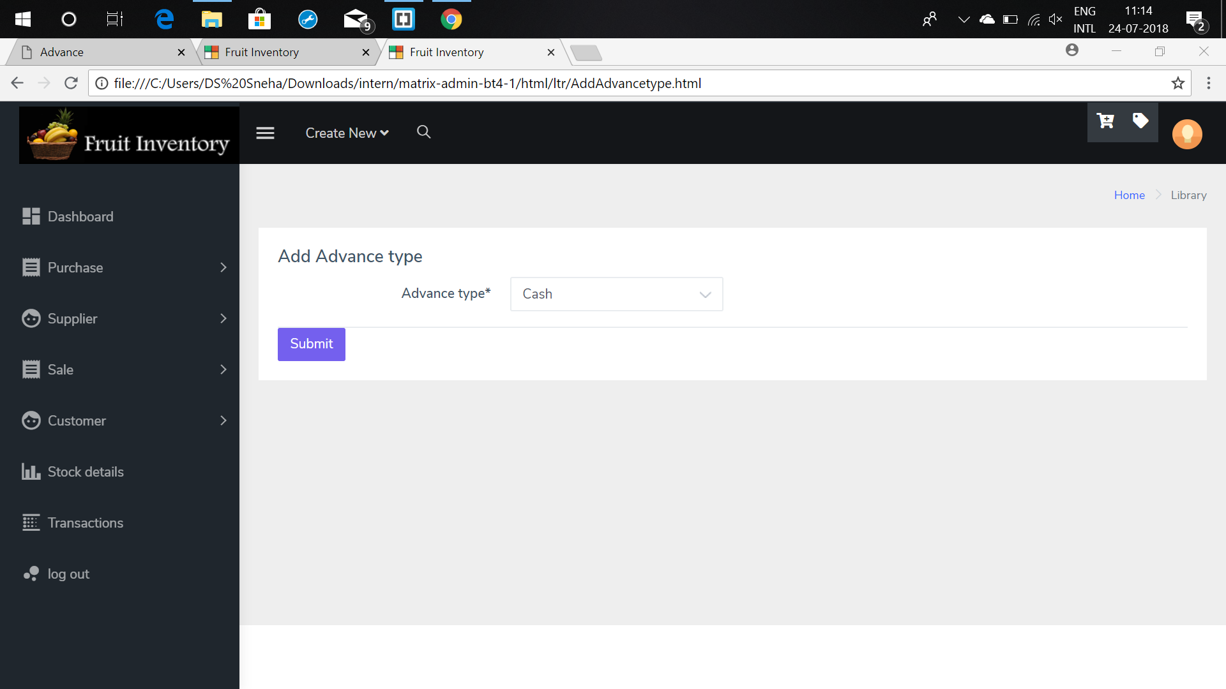
transactions
Add advance type

Slide 76
REQUIREMENTS
Software Requirements
Front End – HTML,CSS,JavaScript.
Middle Layer – Java 8
Back End – MySql
Editor – Brackets,Eclipse(OXYGEN.2)
Operating System – Windows 10
Notes:
© Copyright PresentationGo.com – The free PowerPoint template library

Slide 77
REQUIREMENTS
Hardware Requirements
Processor – core i3/core i5
RAM – 2GB/4GB
Hard-disk – 1TB/2TB
Notes:
© Copyright PresentationGo.com – The free PowerPoint template library

Slide 78


